Slide 1


Energy’s Journey from Farm to You

Slide 2



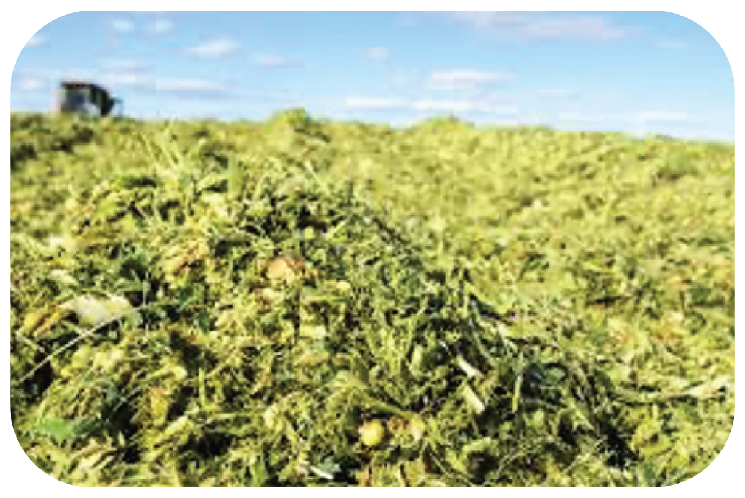
What foods do you see?

Slide 3








Energy from Farm to You 1

Slide 4

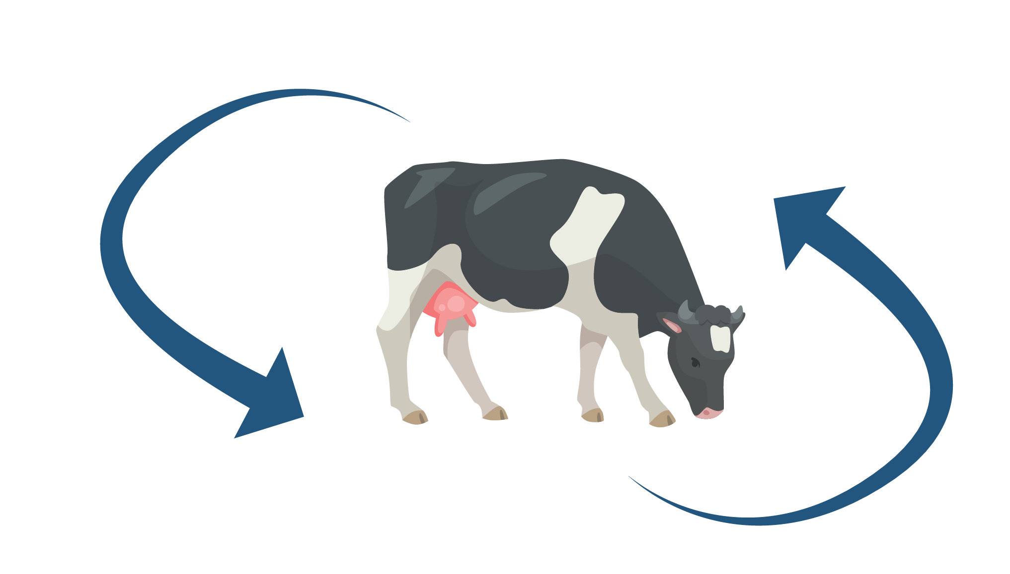
Energy Chain Step-By-Step

Slide 5
Energy from Farm to You 2
Photosynthesis

Slide 6




What do plants need to grow?

Slide 7

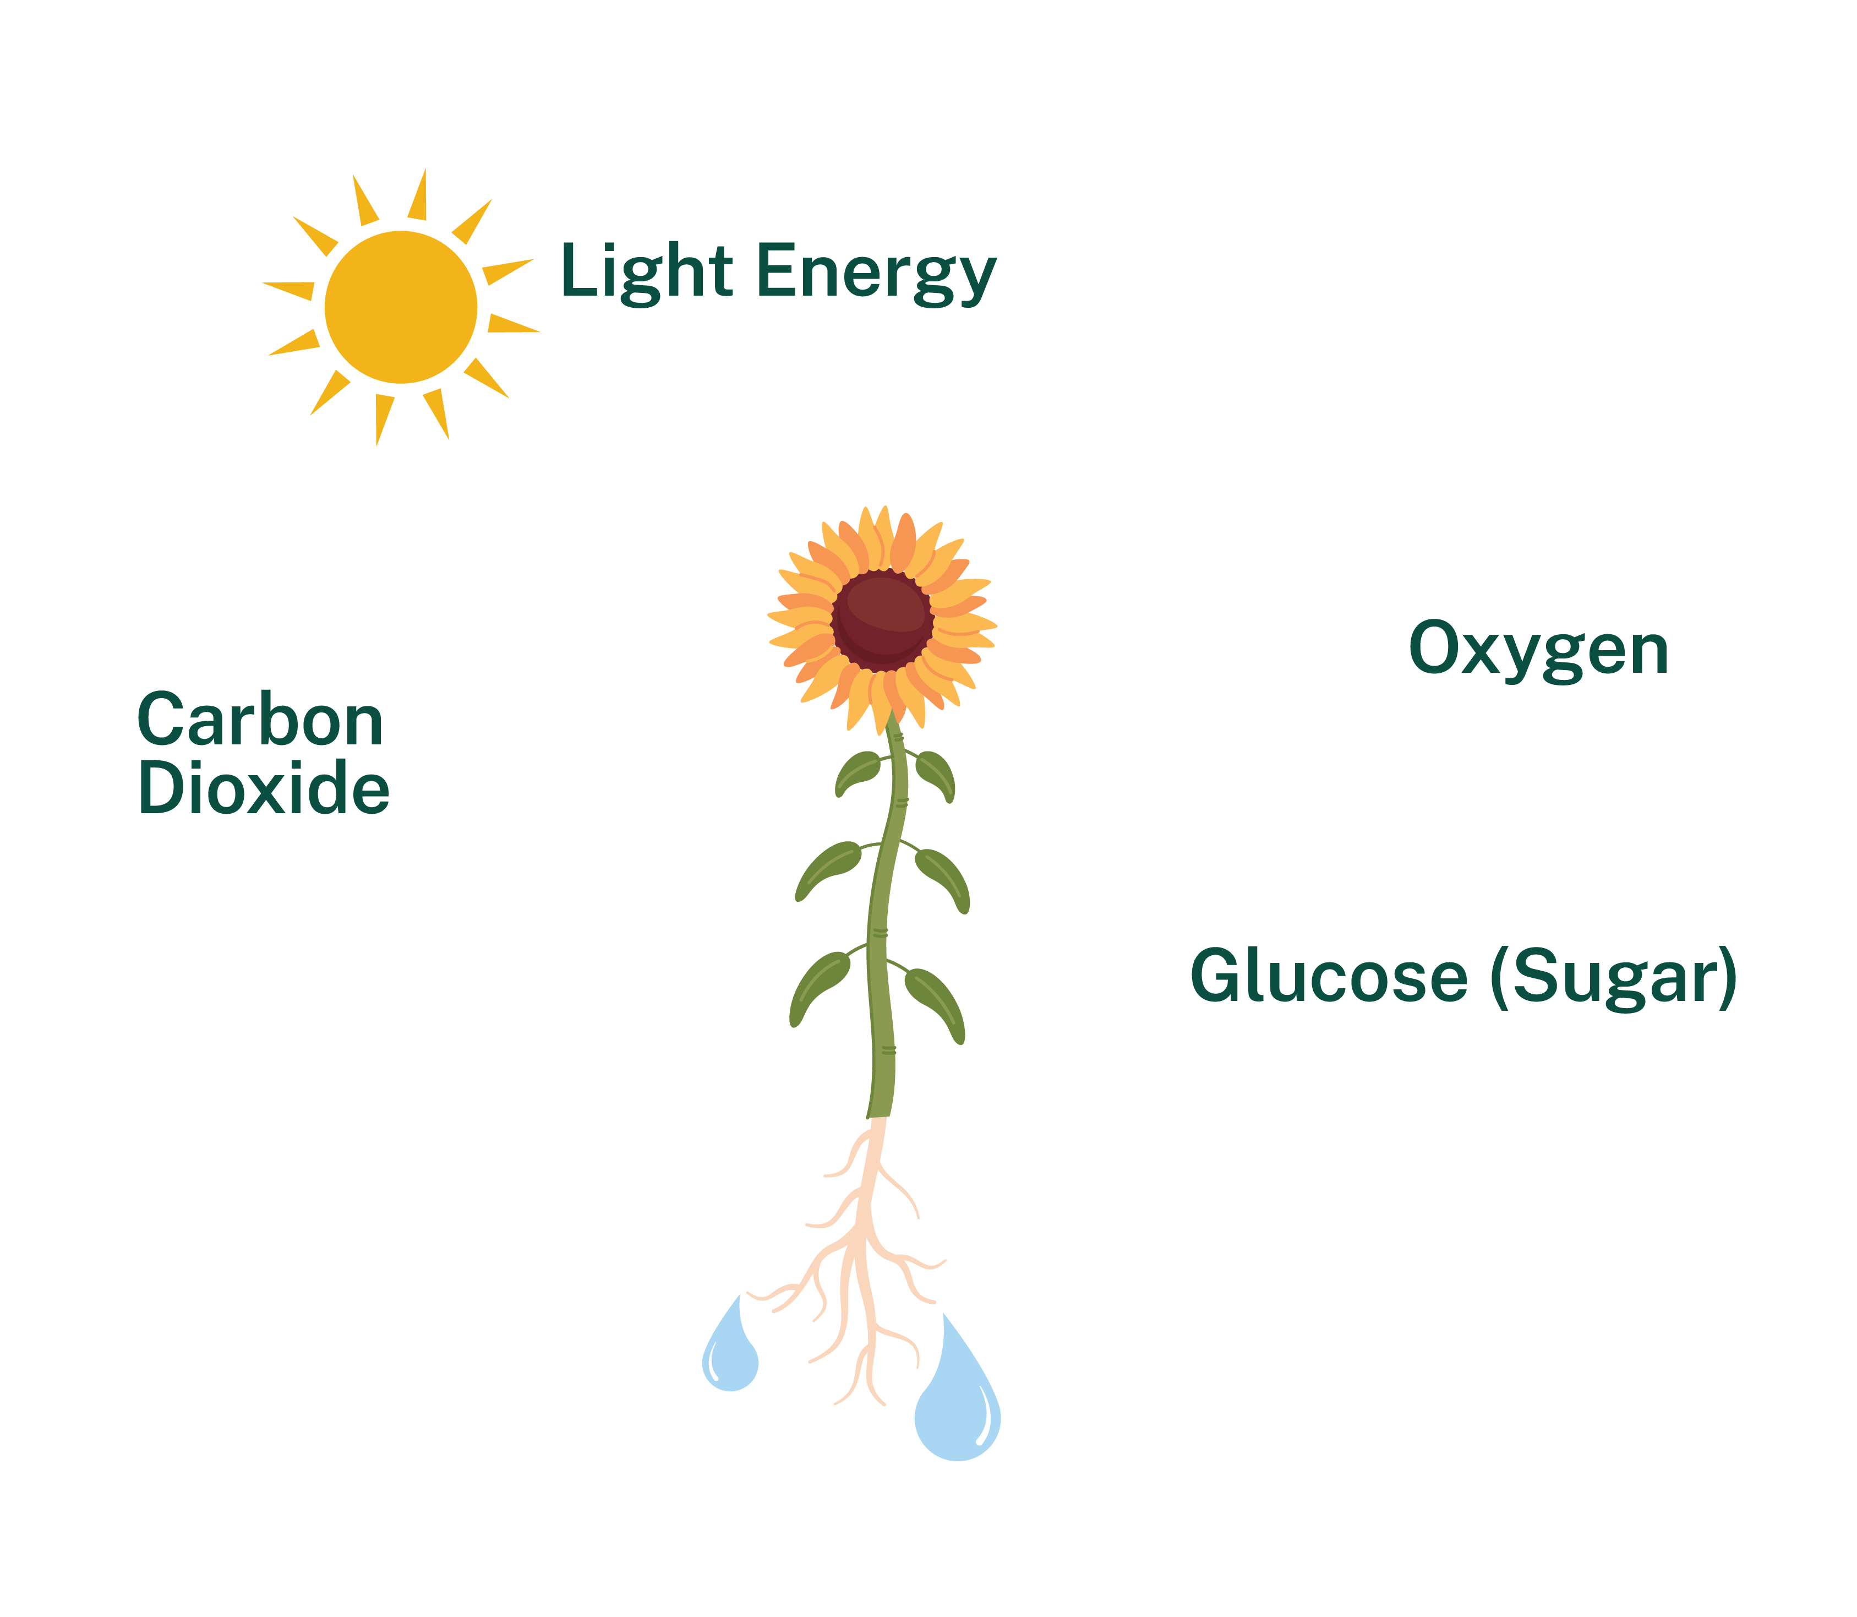

Photosynthesis

Slide 8
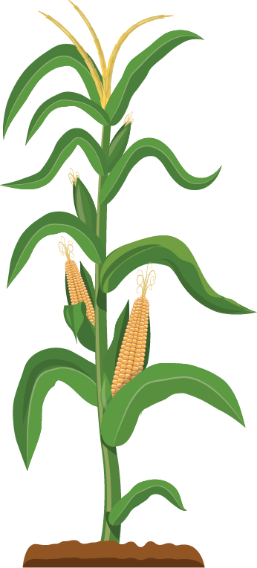
Energy from Farm to You 3
Photosynthesis

Slide 9
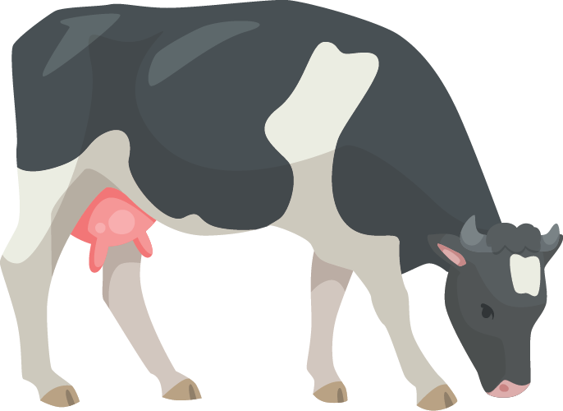
Energy from Farm to You 4
Photosynthesis
Digestion

Slide 10

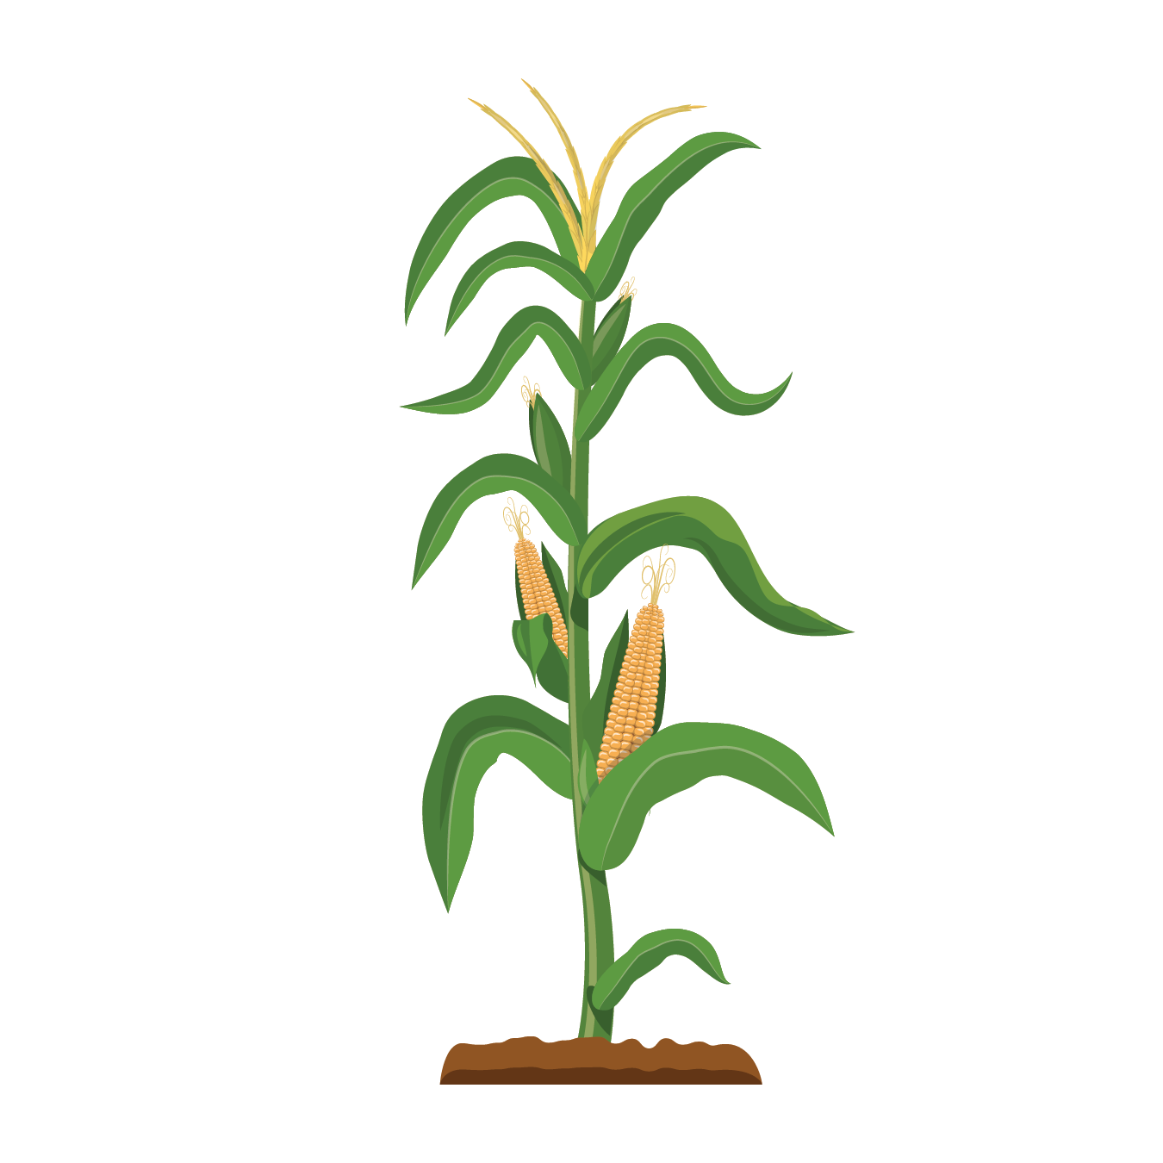



What Plants do the Cows Need to Grow?

Slide 11
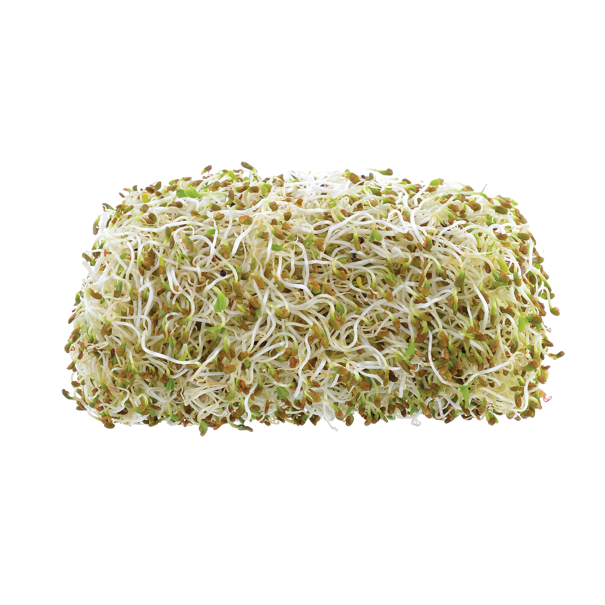
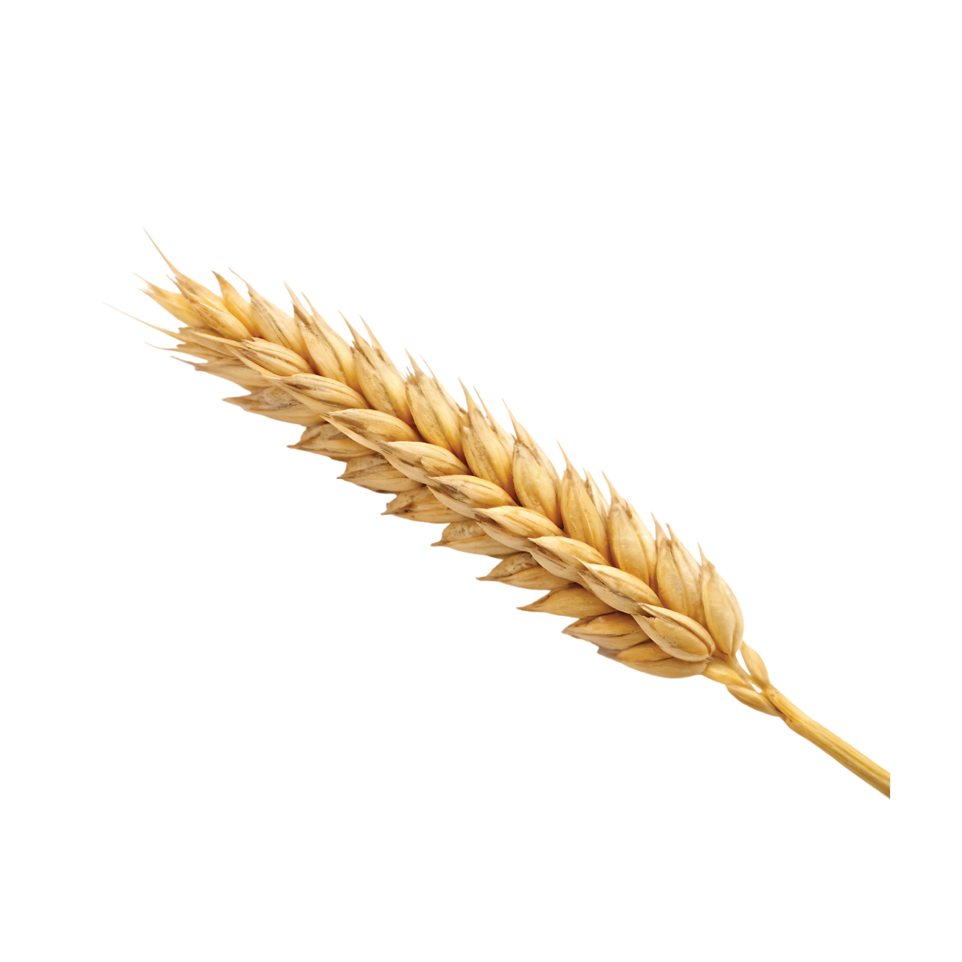
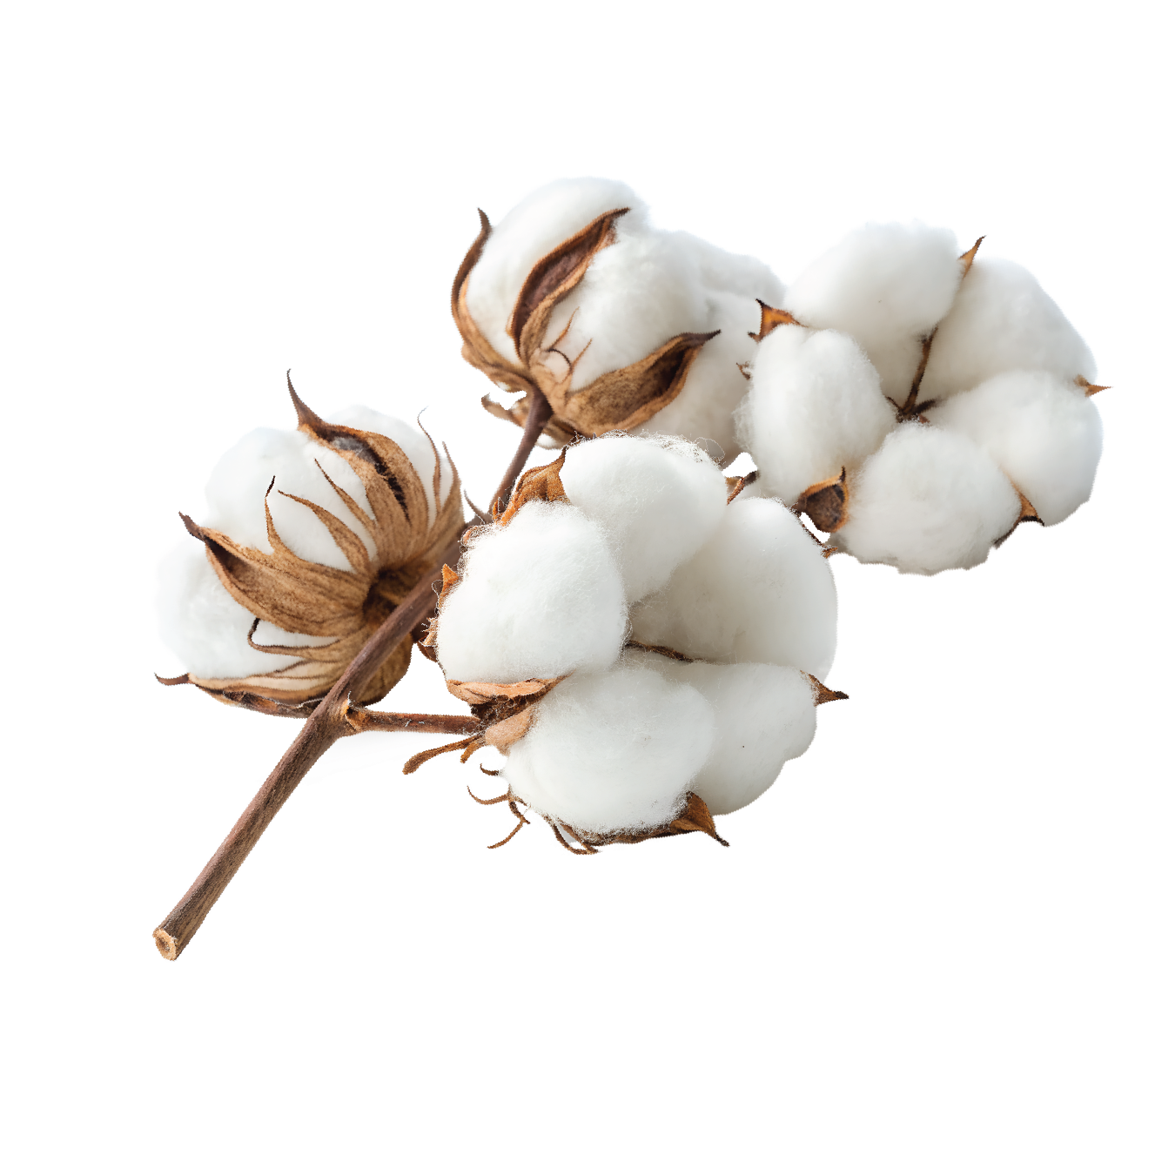
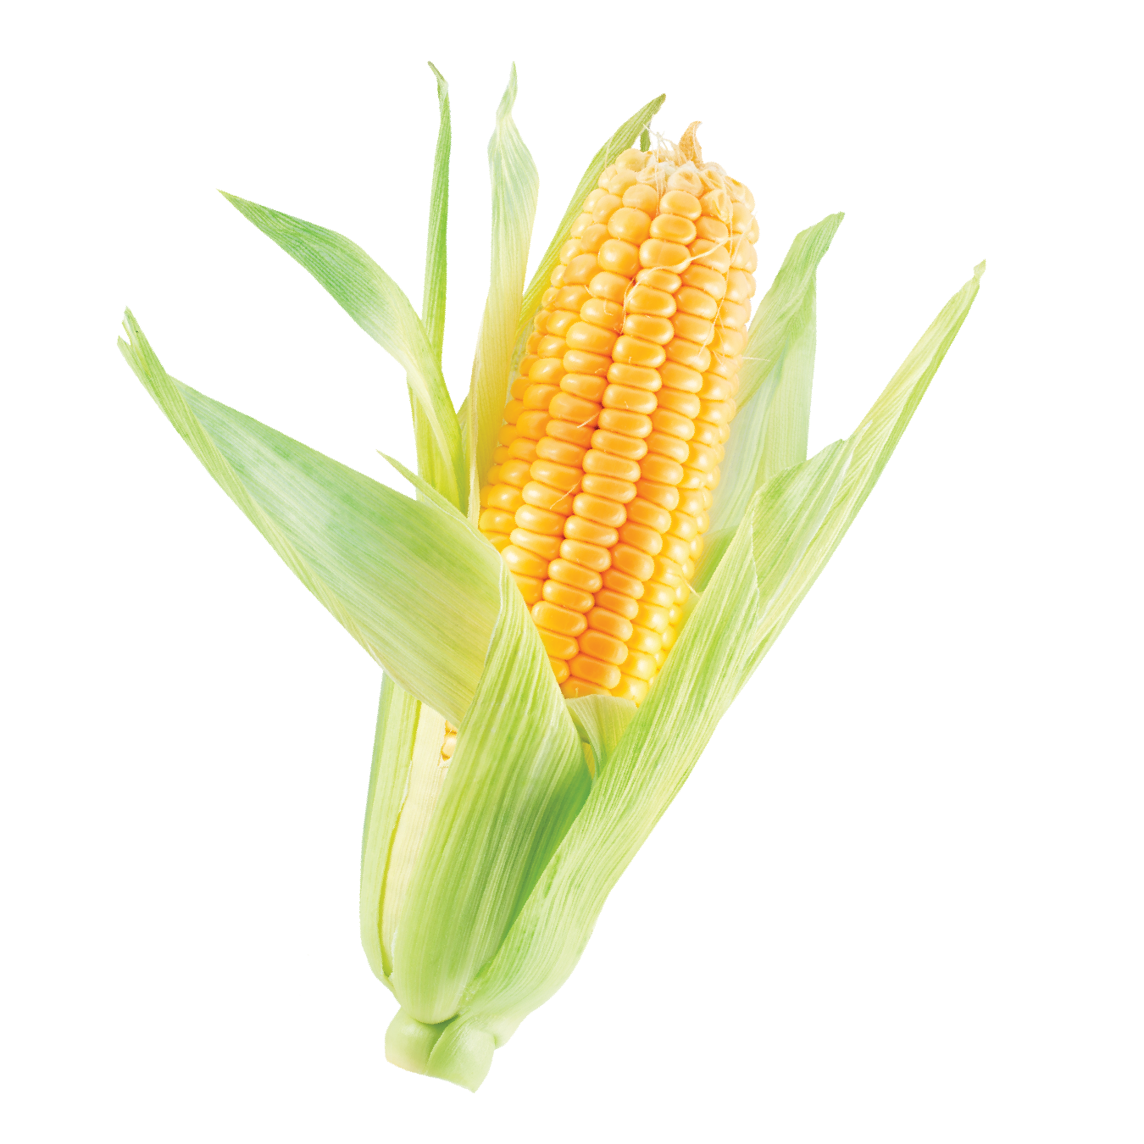
What Plants do the Cows Need to Grow? 2

Slide 12

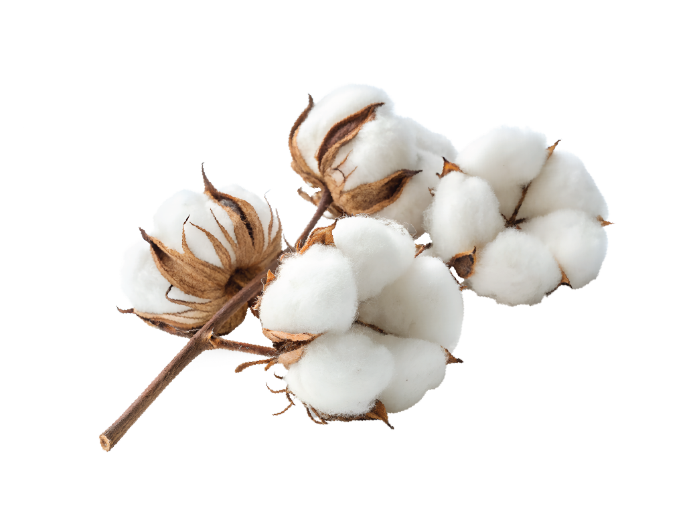

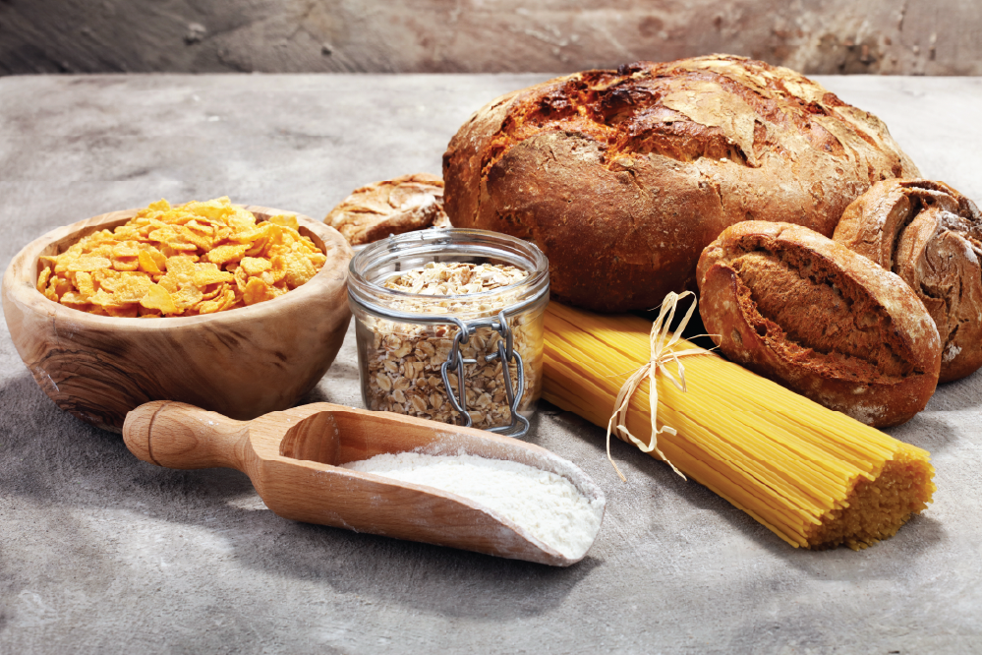
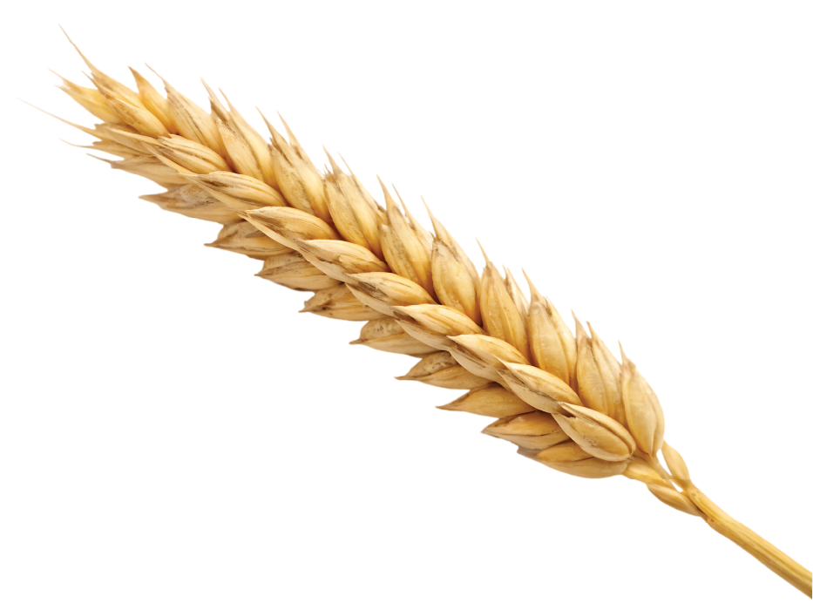

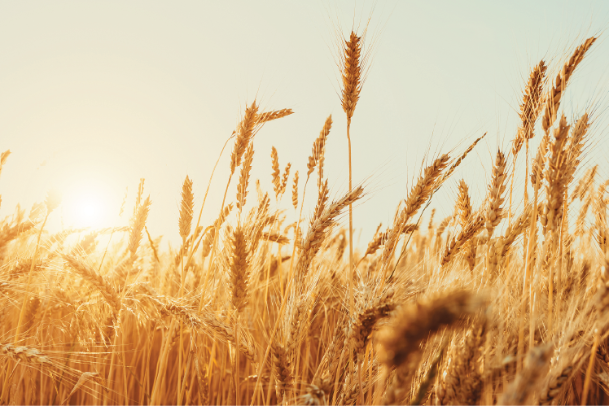




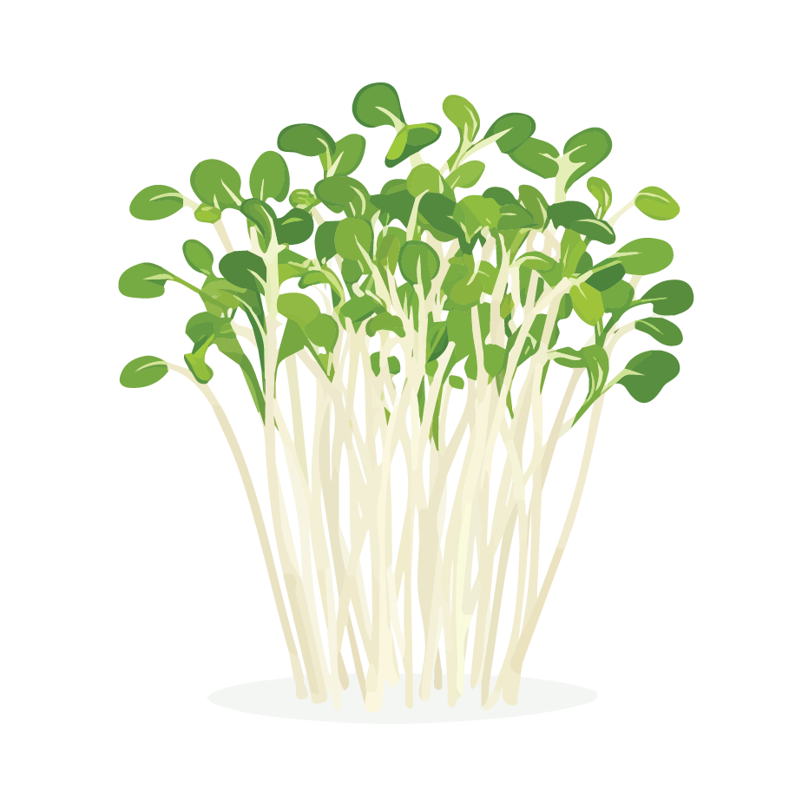
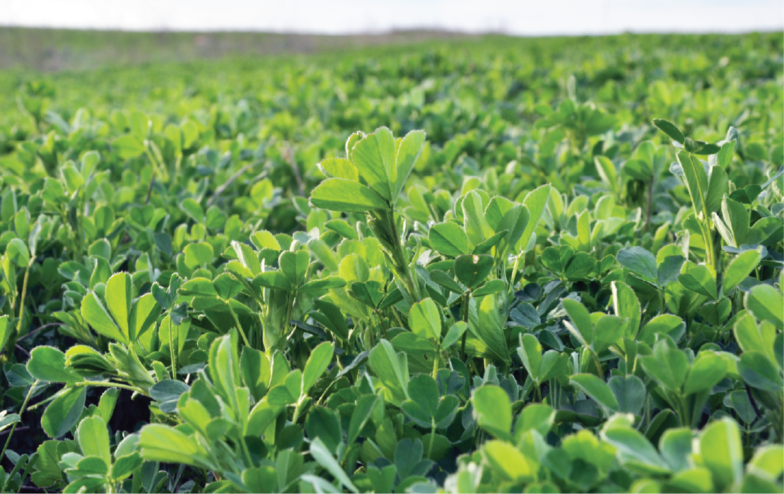

Cotton, Wheat, Alfalfa, and Corn Products

Slide 13

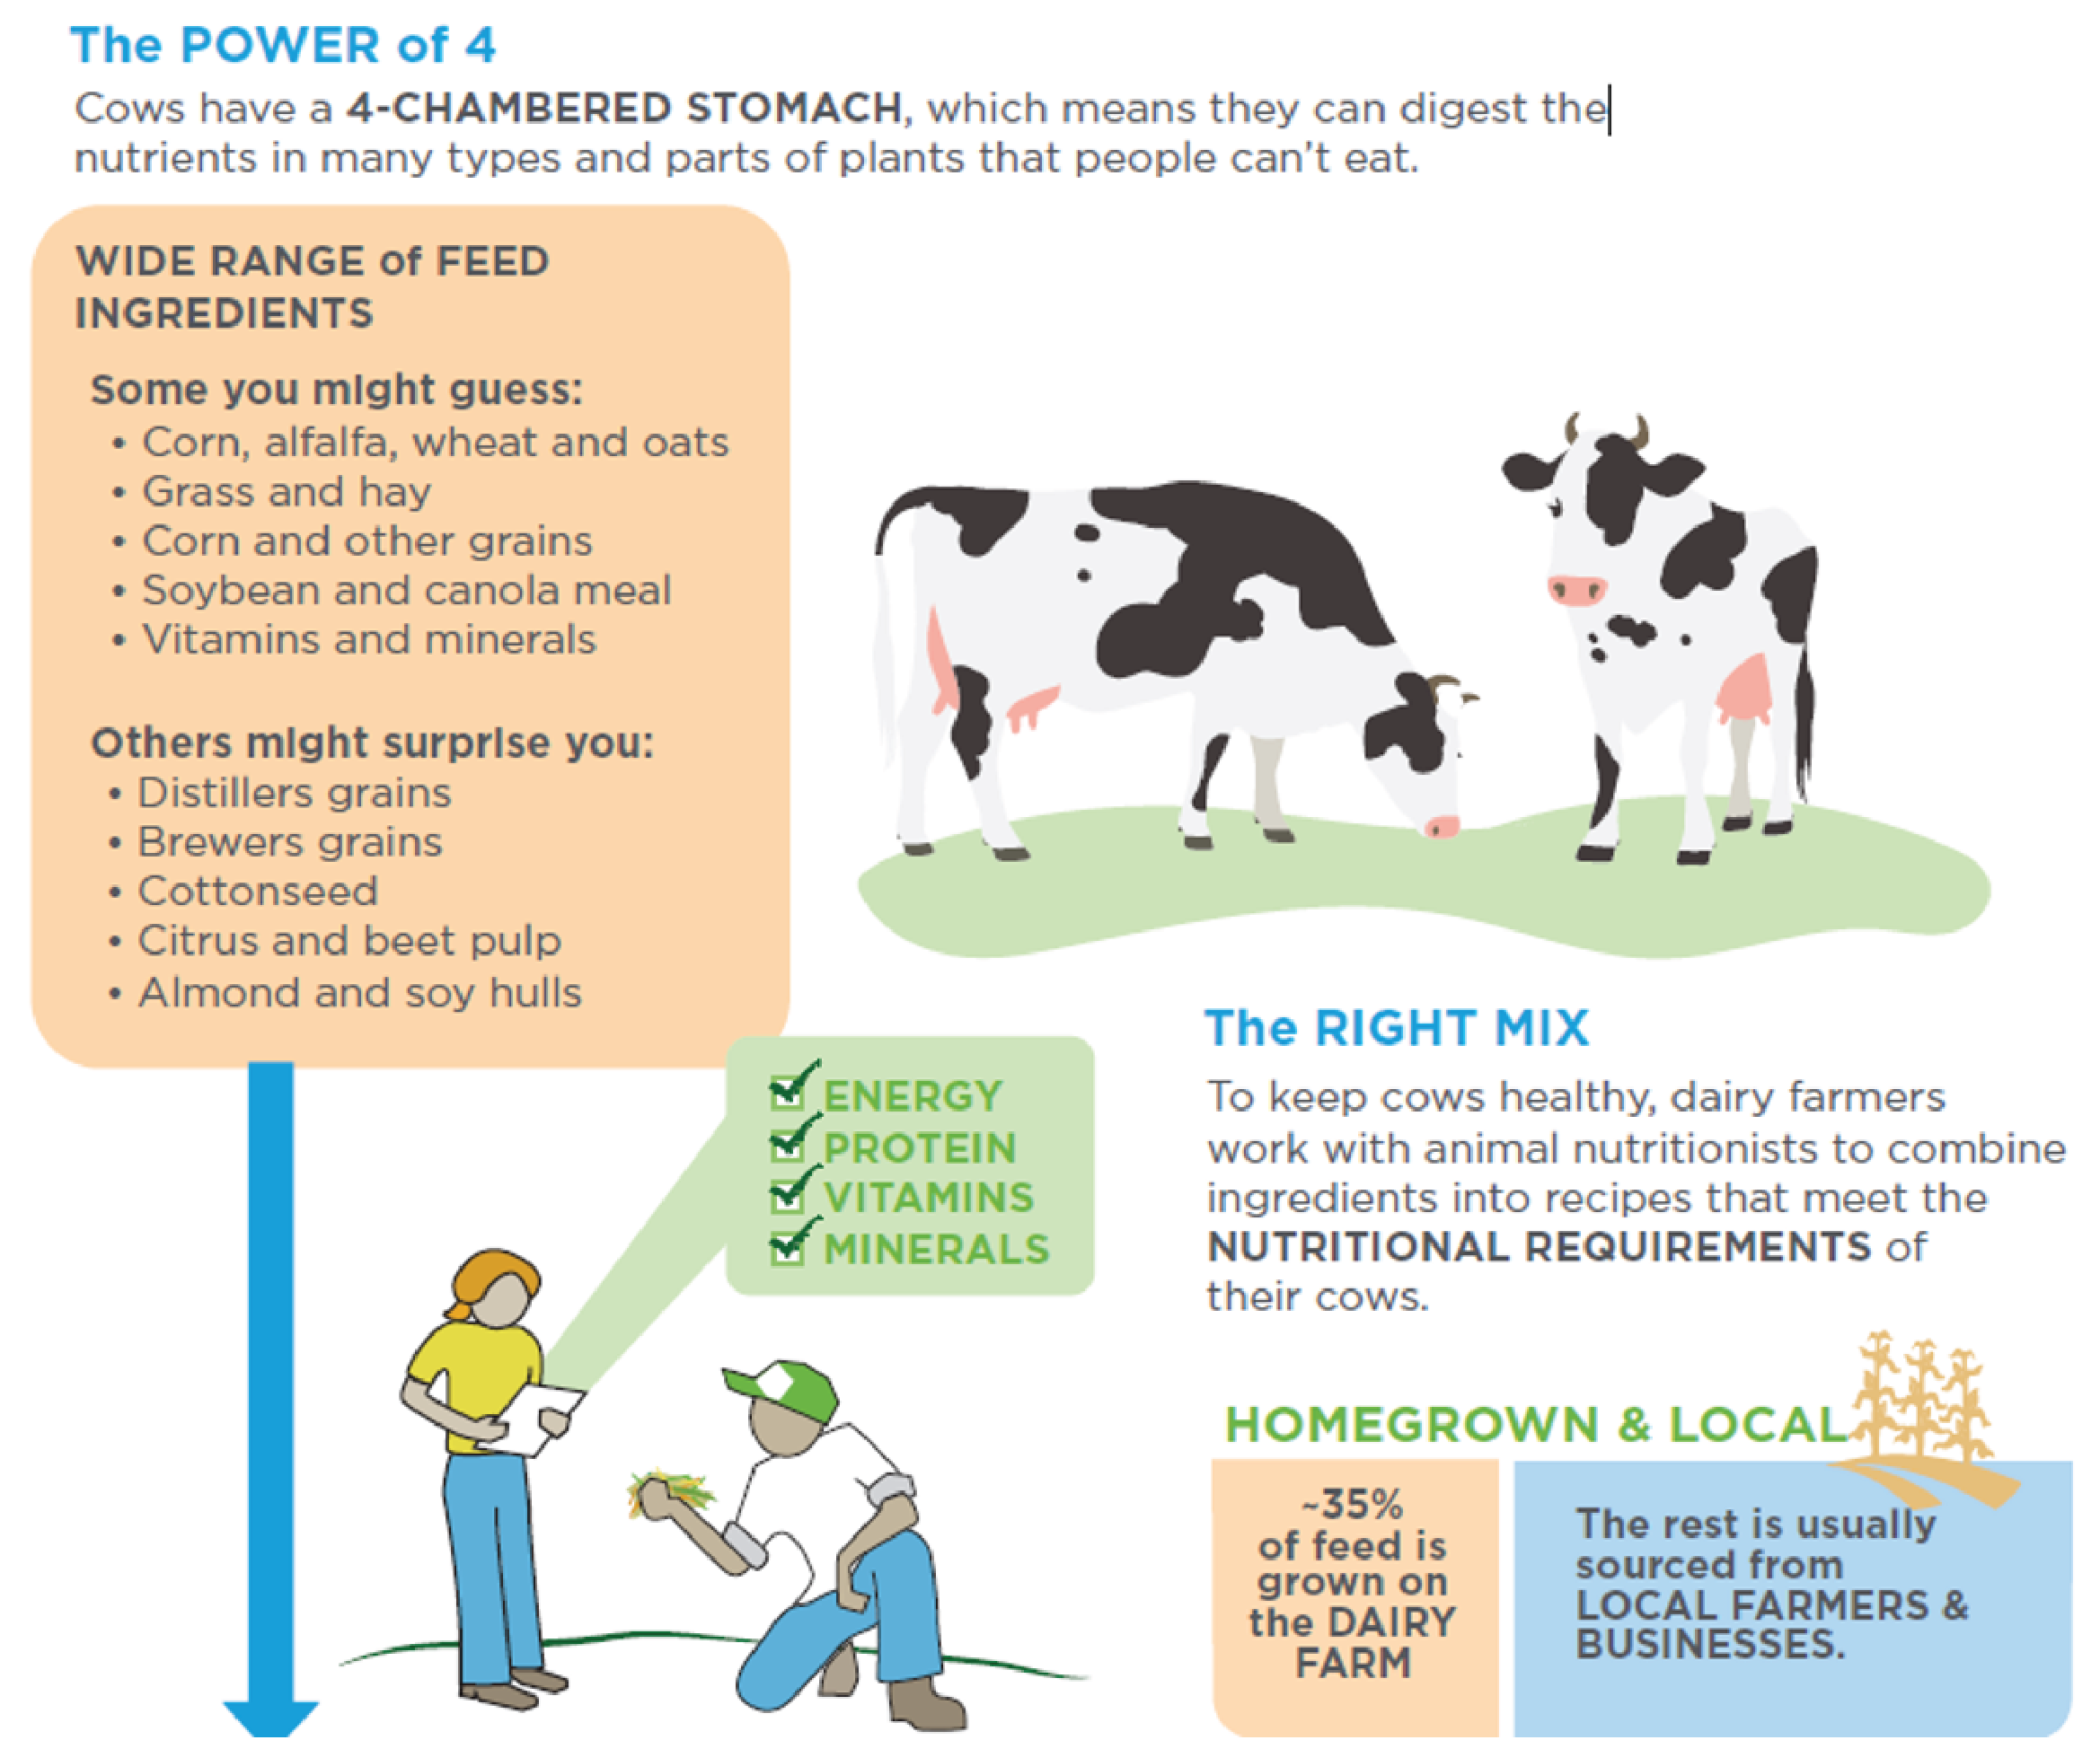
A Healthy Diet for Cows
The Power of 4
Cows have a 4-chambered stomach, which means they can digest the nutrients in many types and parts of plants that people can’t eat.
Wide Range of Feed Ingredients
Some you might guess:
Corn, alfalfa, wheat and oats
Grass and hay
Corn and other grains
Soybean and canola meal
Vitamins and minerals
Others might surprise you:
Distillers grains
Brewers grains
Cottonseed
Citrus and beet pulp
Almond and soy hulls
The Right Mix
To keep cows healthy, dairy farmers work with animal nutritionists to combine ingredients into recipes that meet the nutritional requirements of their cows.
Energy
Protein
Vitamins
Minerals
Homegrown and Local
~35% of feed is grown on the dairy farm. The rest is usually sourced from local farmers and businesses.

Slide 14


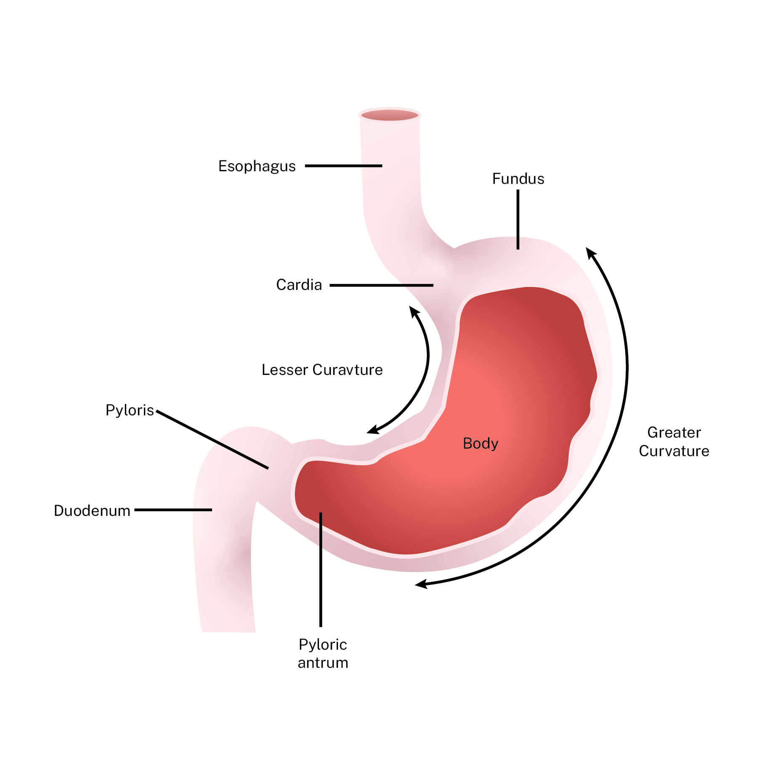
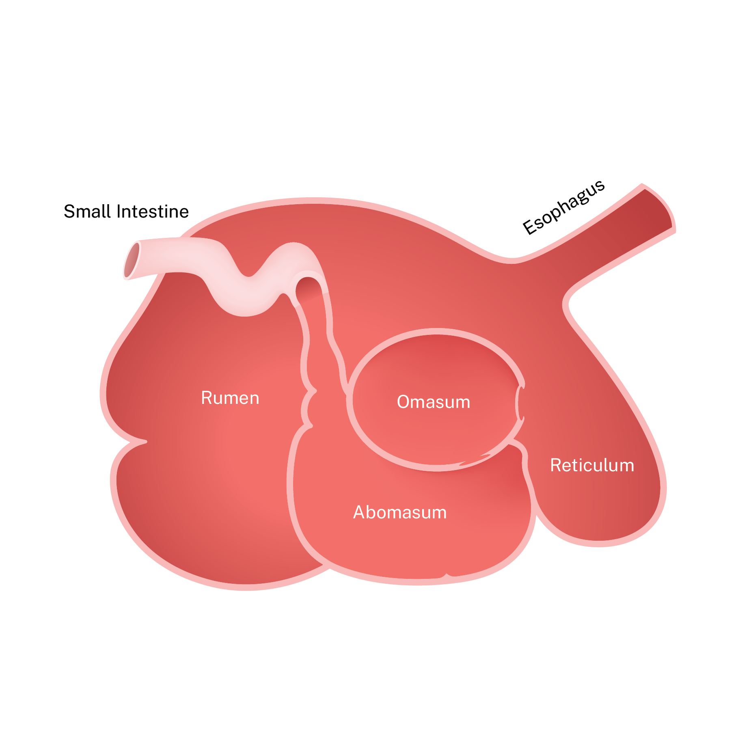
Human and Cow Stomachs

Slide 15
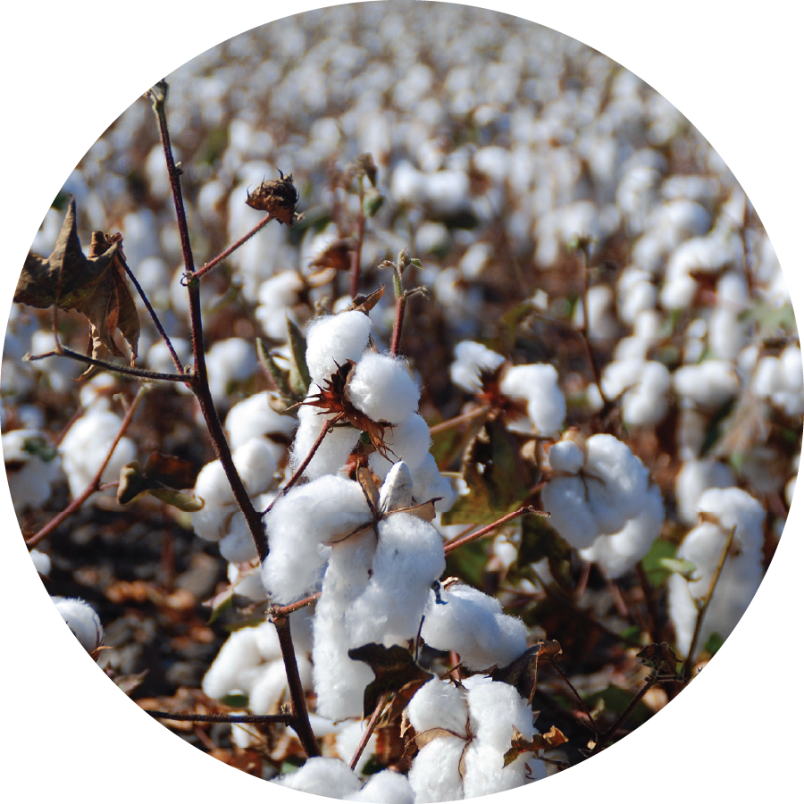
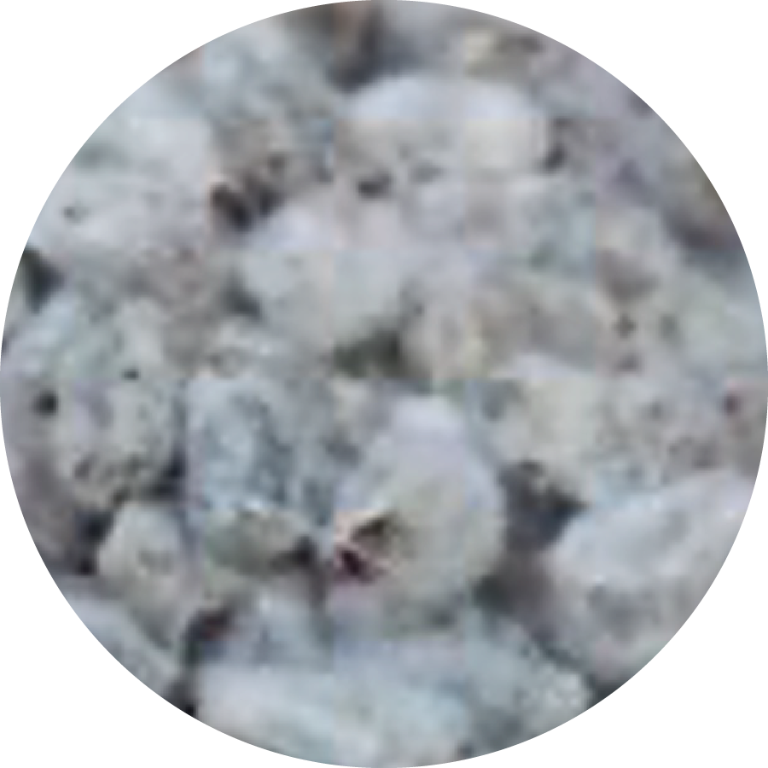
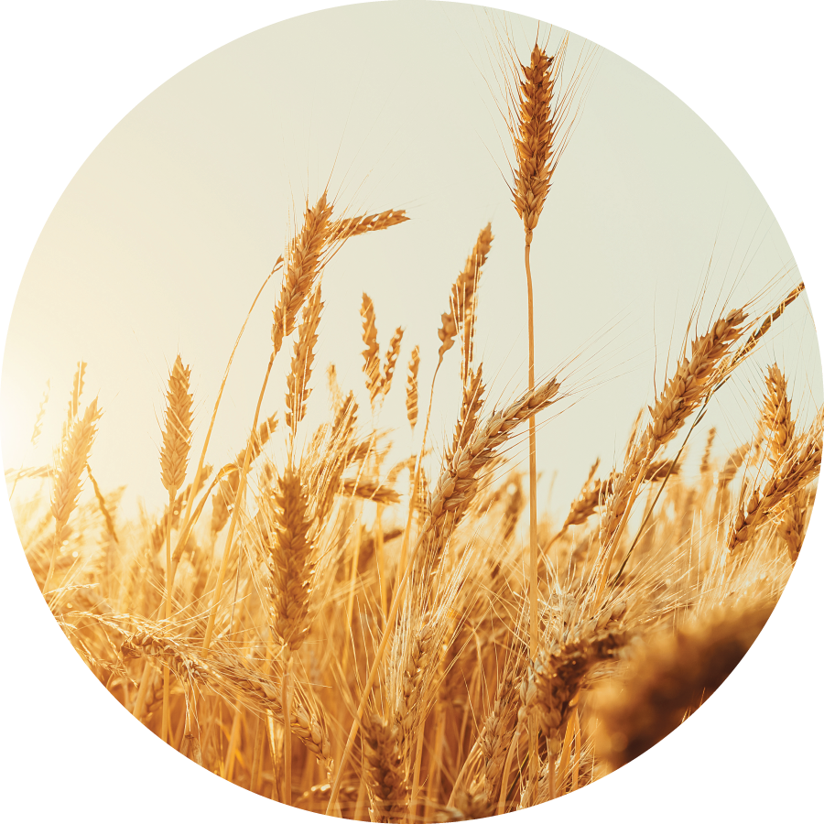

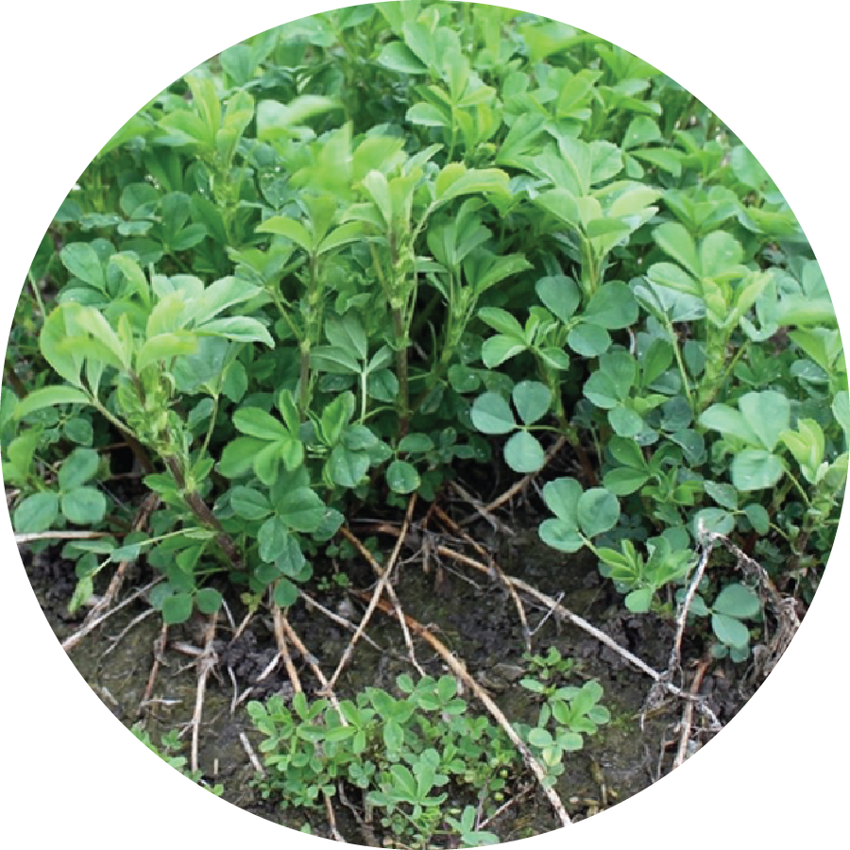
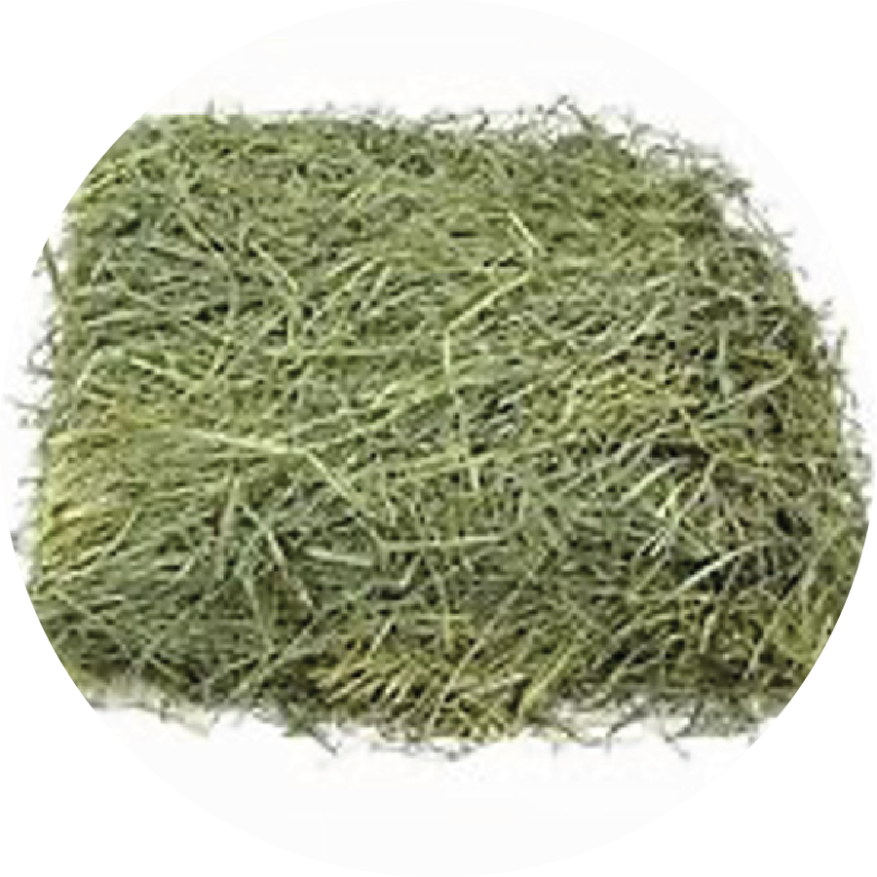
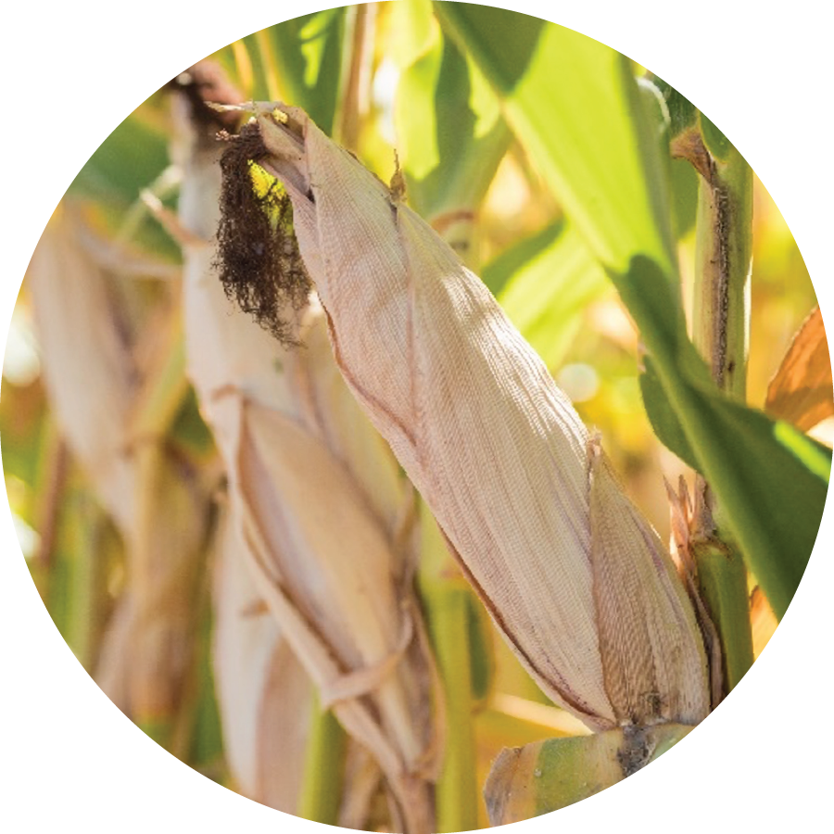
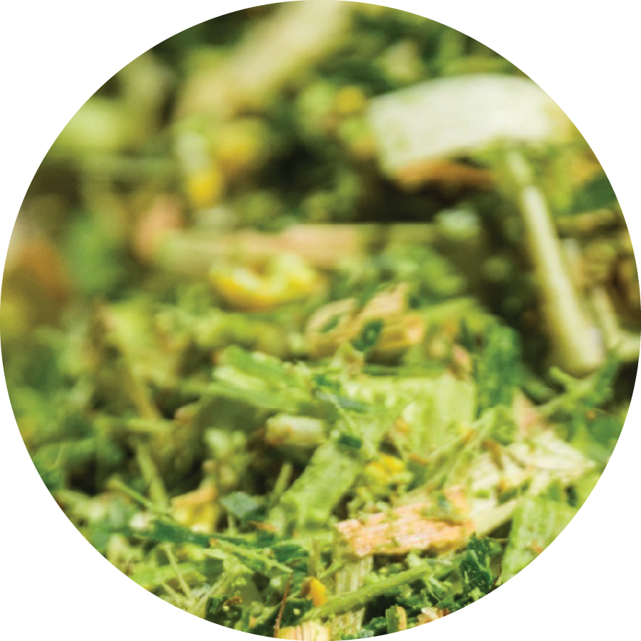
Cotton, wheat, alfalfa, and corn By-products
Cotton
Cottonseed
Wheat
Mill Run
Alfalfa
Alfalfa Hay
Corn
Corn Silage

Slide 16
Energy from Farm to You 5
Photosynthesis
Digestion

Slide 17

Energy from Farm to You 6
Photosynthesis
Digestion

Slide 18

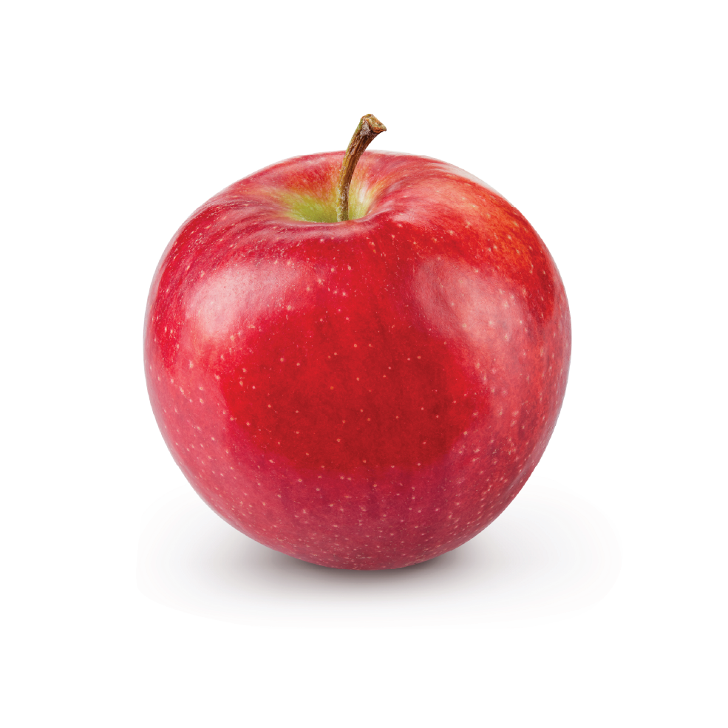

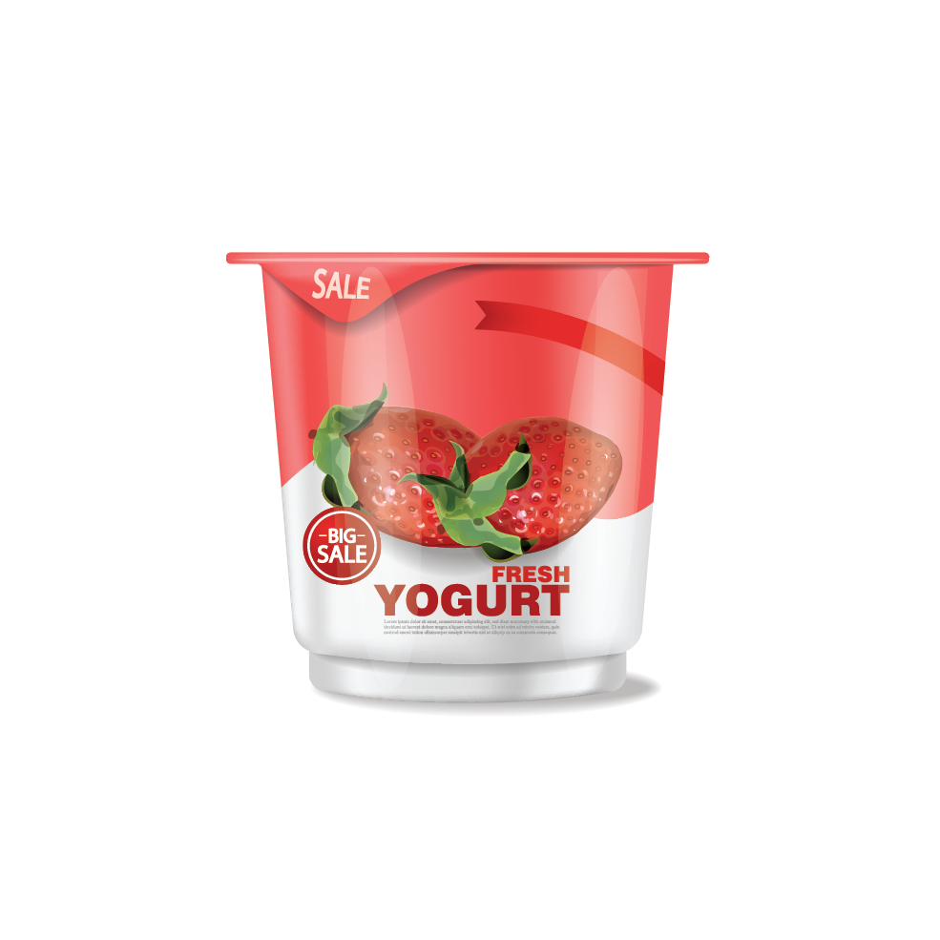

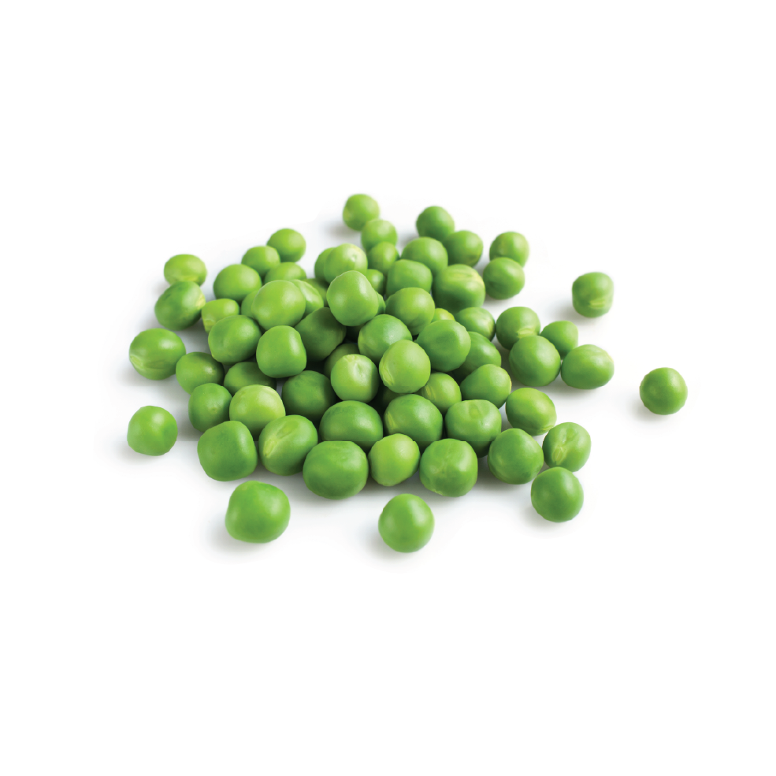
Which of the Following is a Dairy Food?

Slide 19
Energy from Farm to You 7
Photosynthesis
Digestion

Slide 20

Energy from Farm to You 8
Photosynthesis
Digestion

