Slide 1
Maps of the probability of a cloud free Landsat scene during the growing season

Slide 2
Summary
Probability of a cloud free image no more than 16 and 32 days apart during the growing season
Still using a fixed growing season
  April 1st to Oct 31st
Using MODIS MOD09GA State QA product to determine cloud free pixels
  2000-2011 (12 years/growing seasons)
  Assumed cloud if cloud state was cloudy or mixed, cloud shadow flag was set, or cirrus detected state was small, average, or high
Landsat revisits same spot every 16 days
  Maps are an average of the separate probabilities from each of the 16 possible return cycle dates

Slide 3
Production of Images
The following images were produced by Charles Morton of the Desert Research Institute in collaboration with Dr. Justin Huntington of DRI and Richard Allen of the University of Idaho

Slide 4
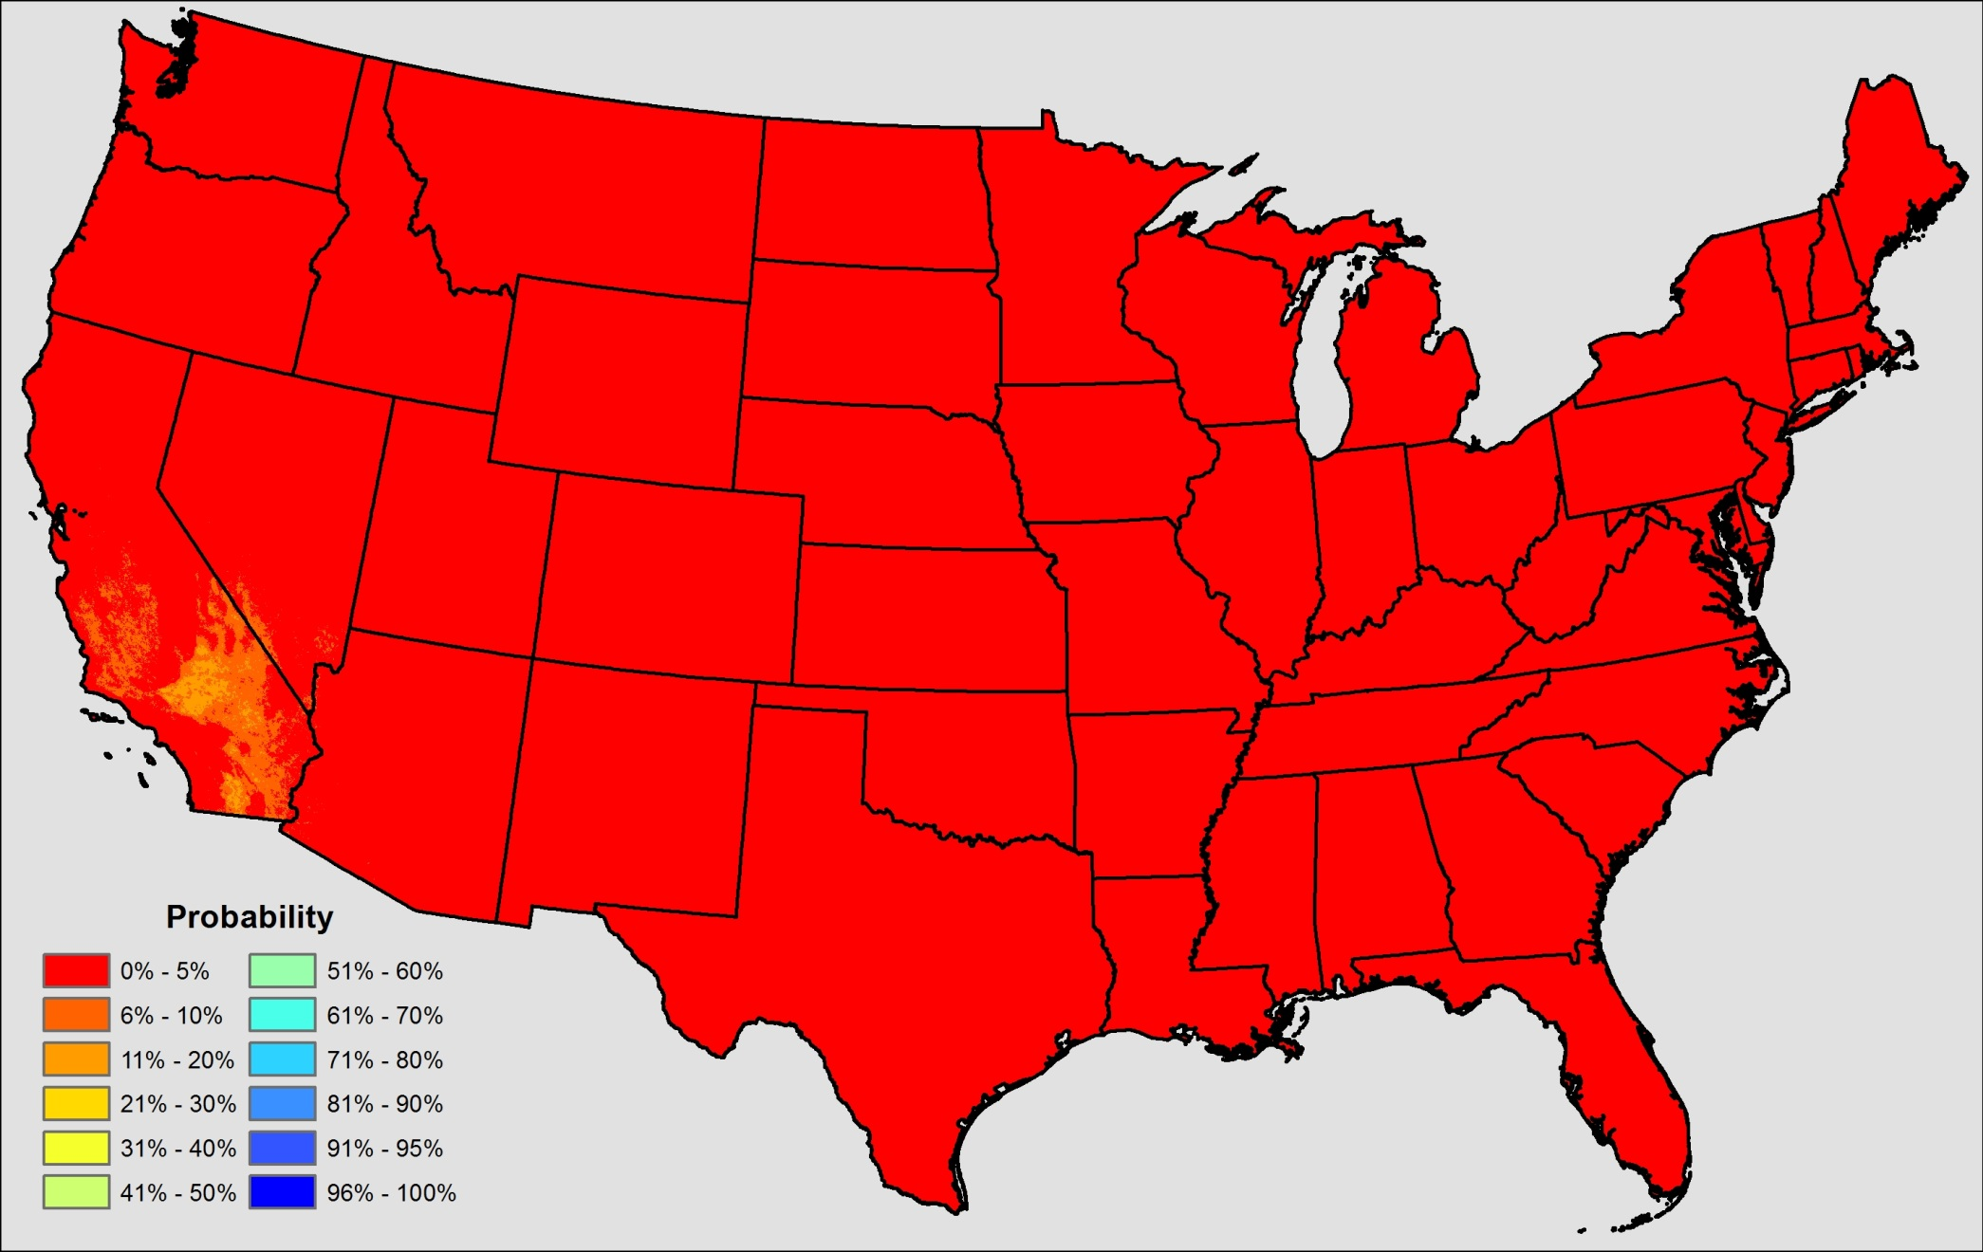
1 Satellite
Cloud free at least every 16 days

Slide 5
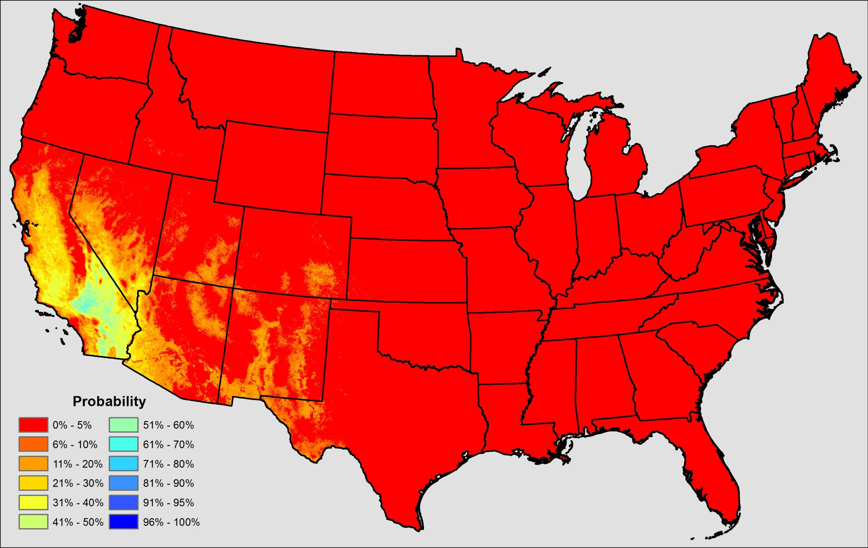
2 Satellites
Cloud free at least every 16 days

Slide 6
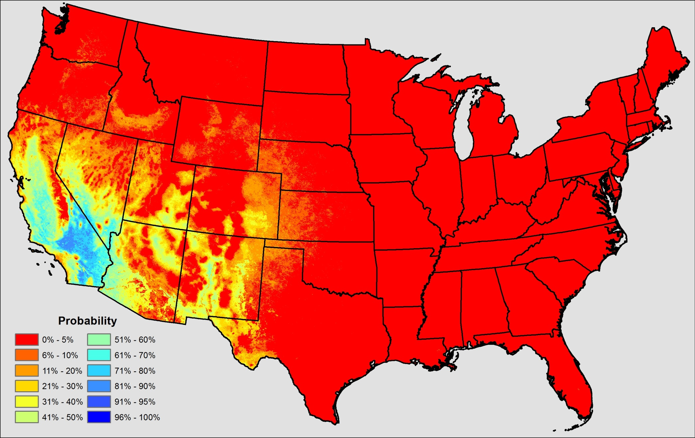
3 Satellites
Cloud free at least every 16 days

Slide 7
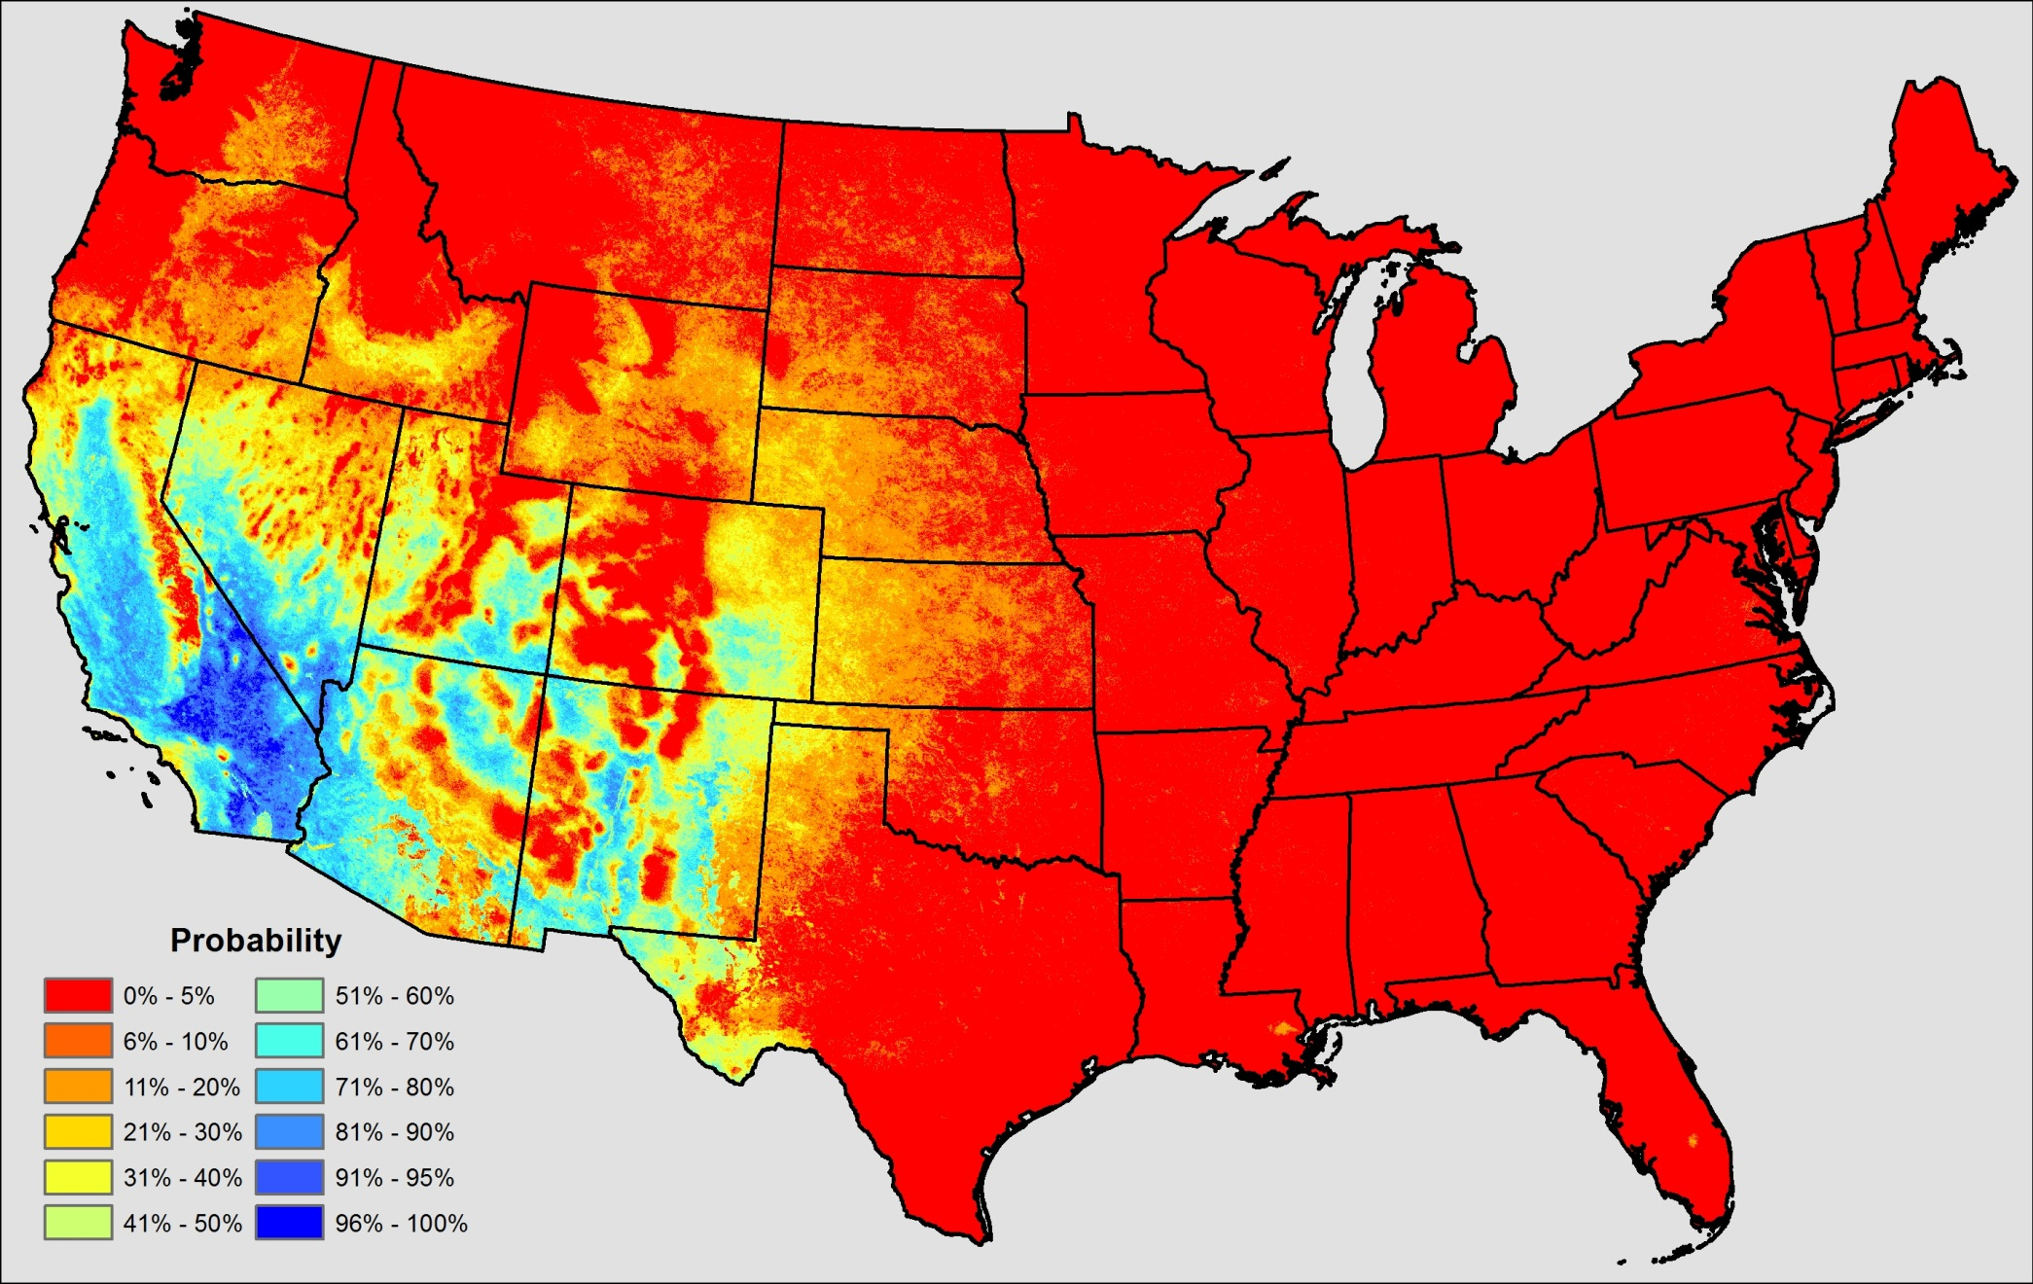
4 Satellites
Cloud free at least every 16 days

Slide 8
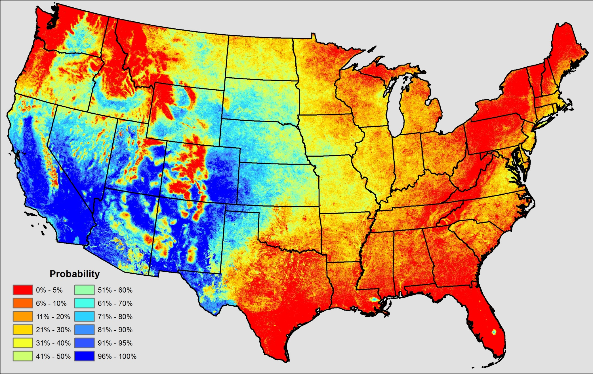
8 Satellites
Cloud free at least every 16 days

Slide 9
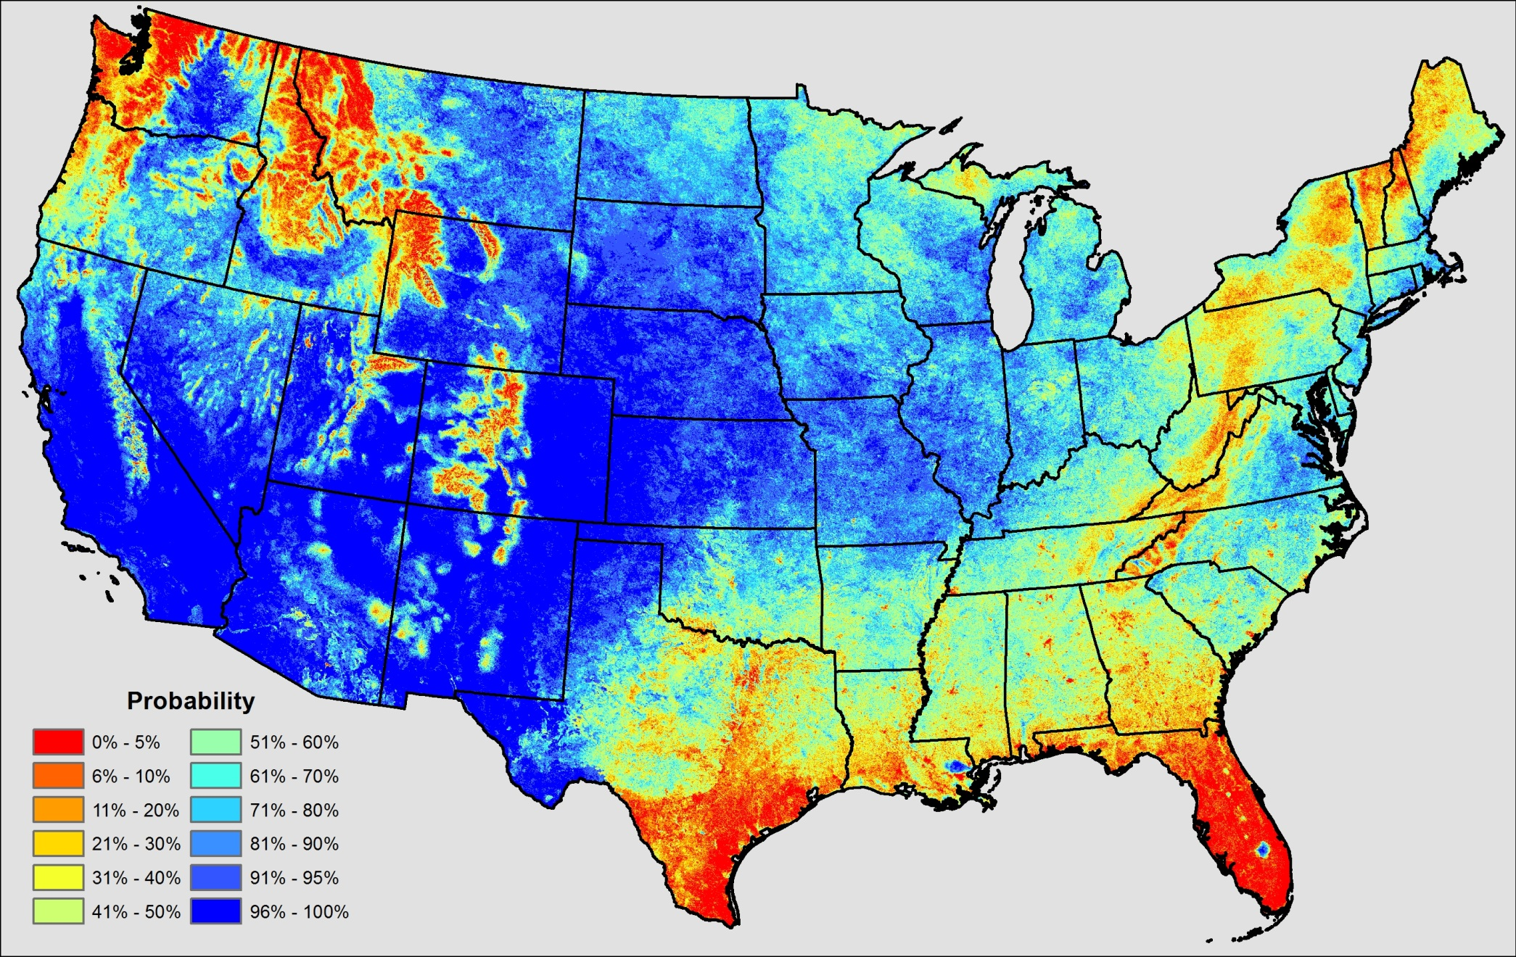
16 Satellites
Cloud free at least every 16 days

Slide 10
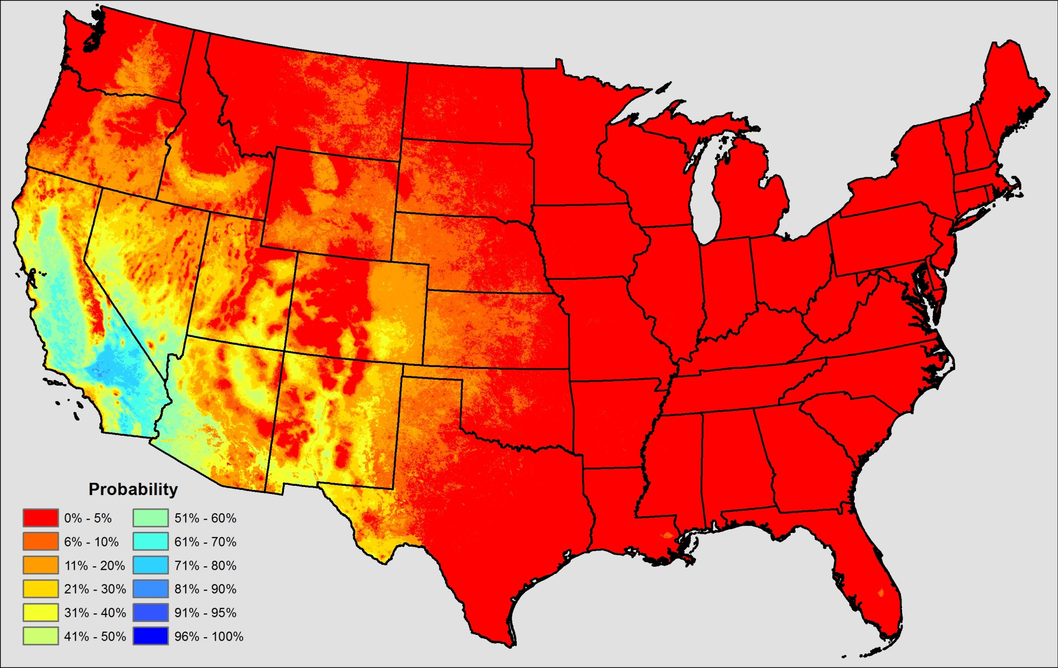
1 Satellite
Cloud free at least every 32 days

Slide 11
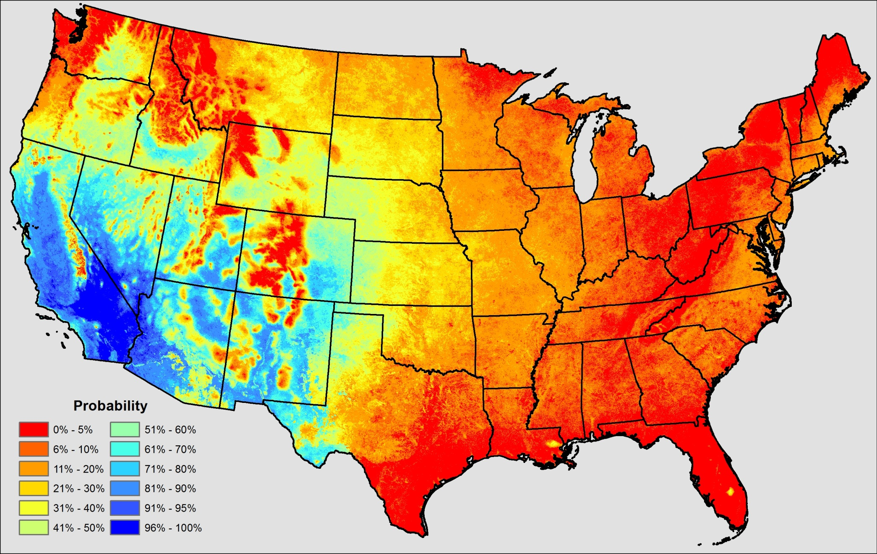
2 Satellites
Cloud free at least every 32 days

Slide 12
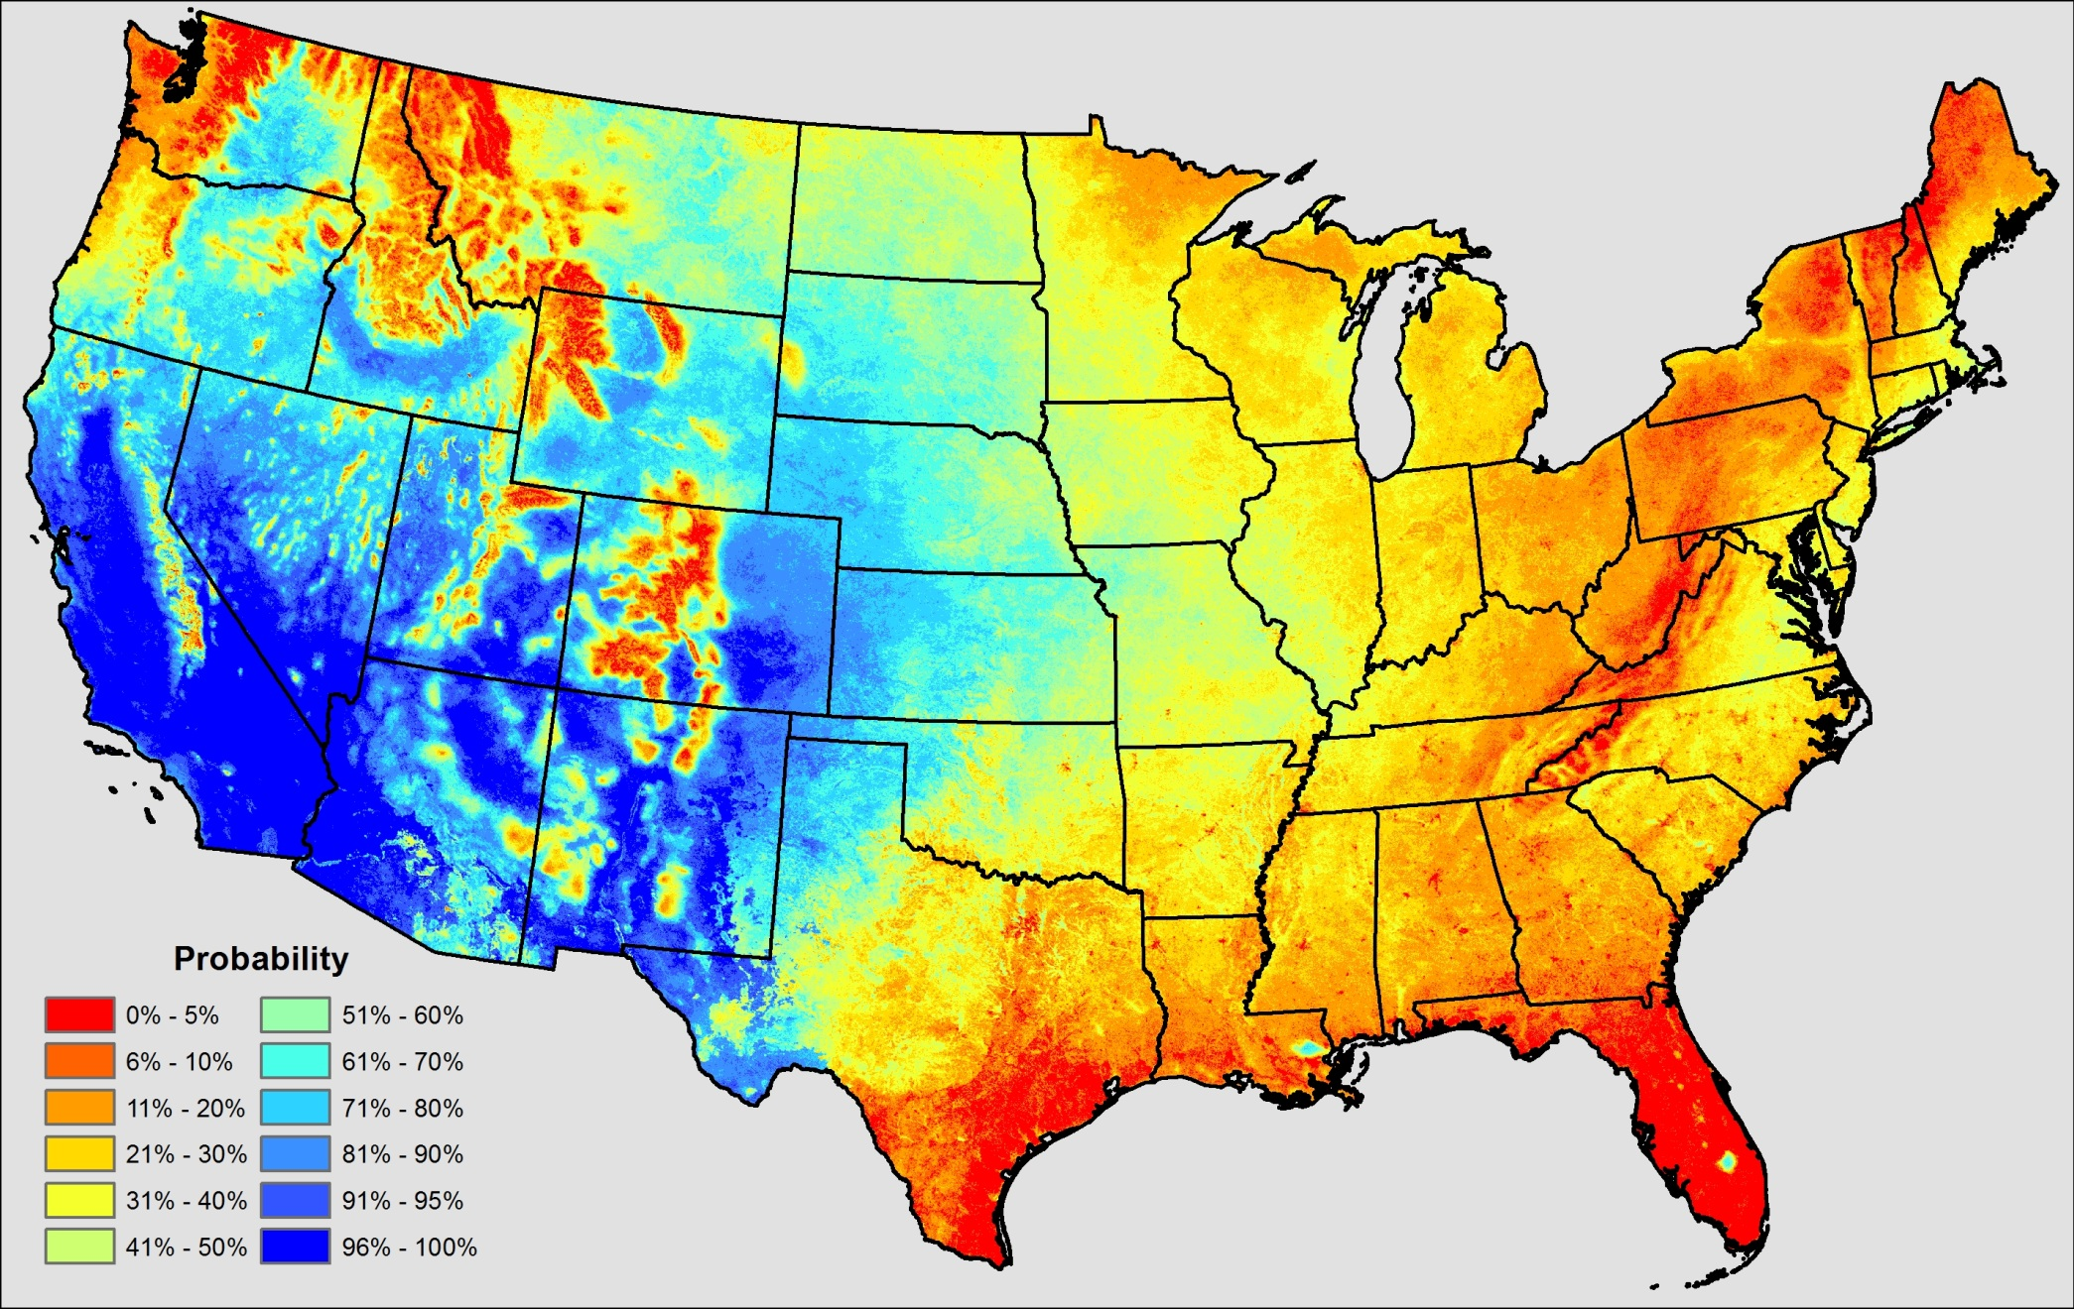
3 Satellites
Cloud free at least every 32 days

Slide 13
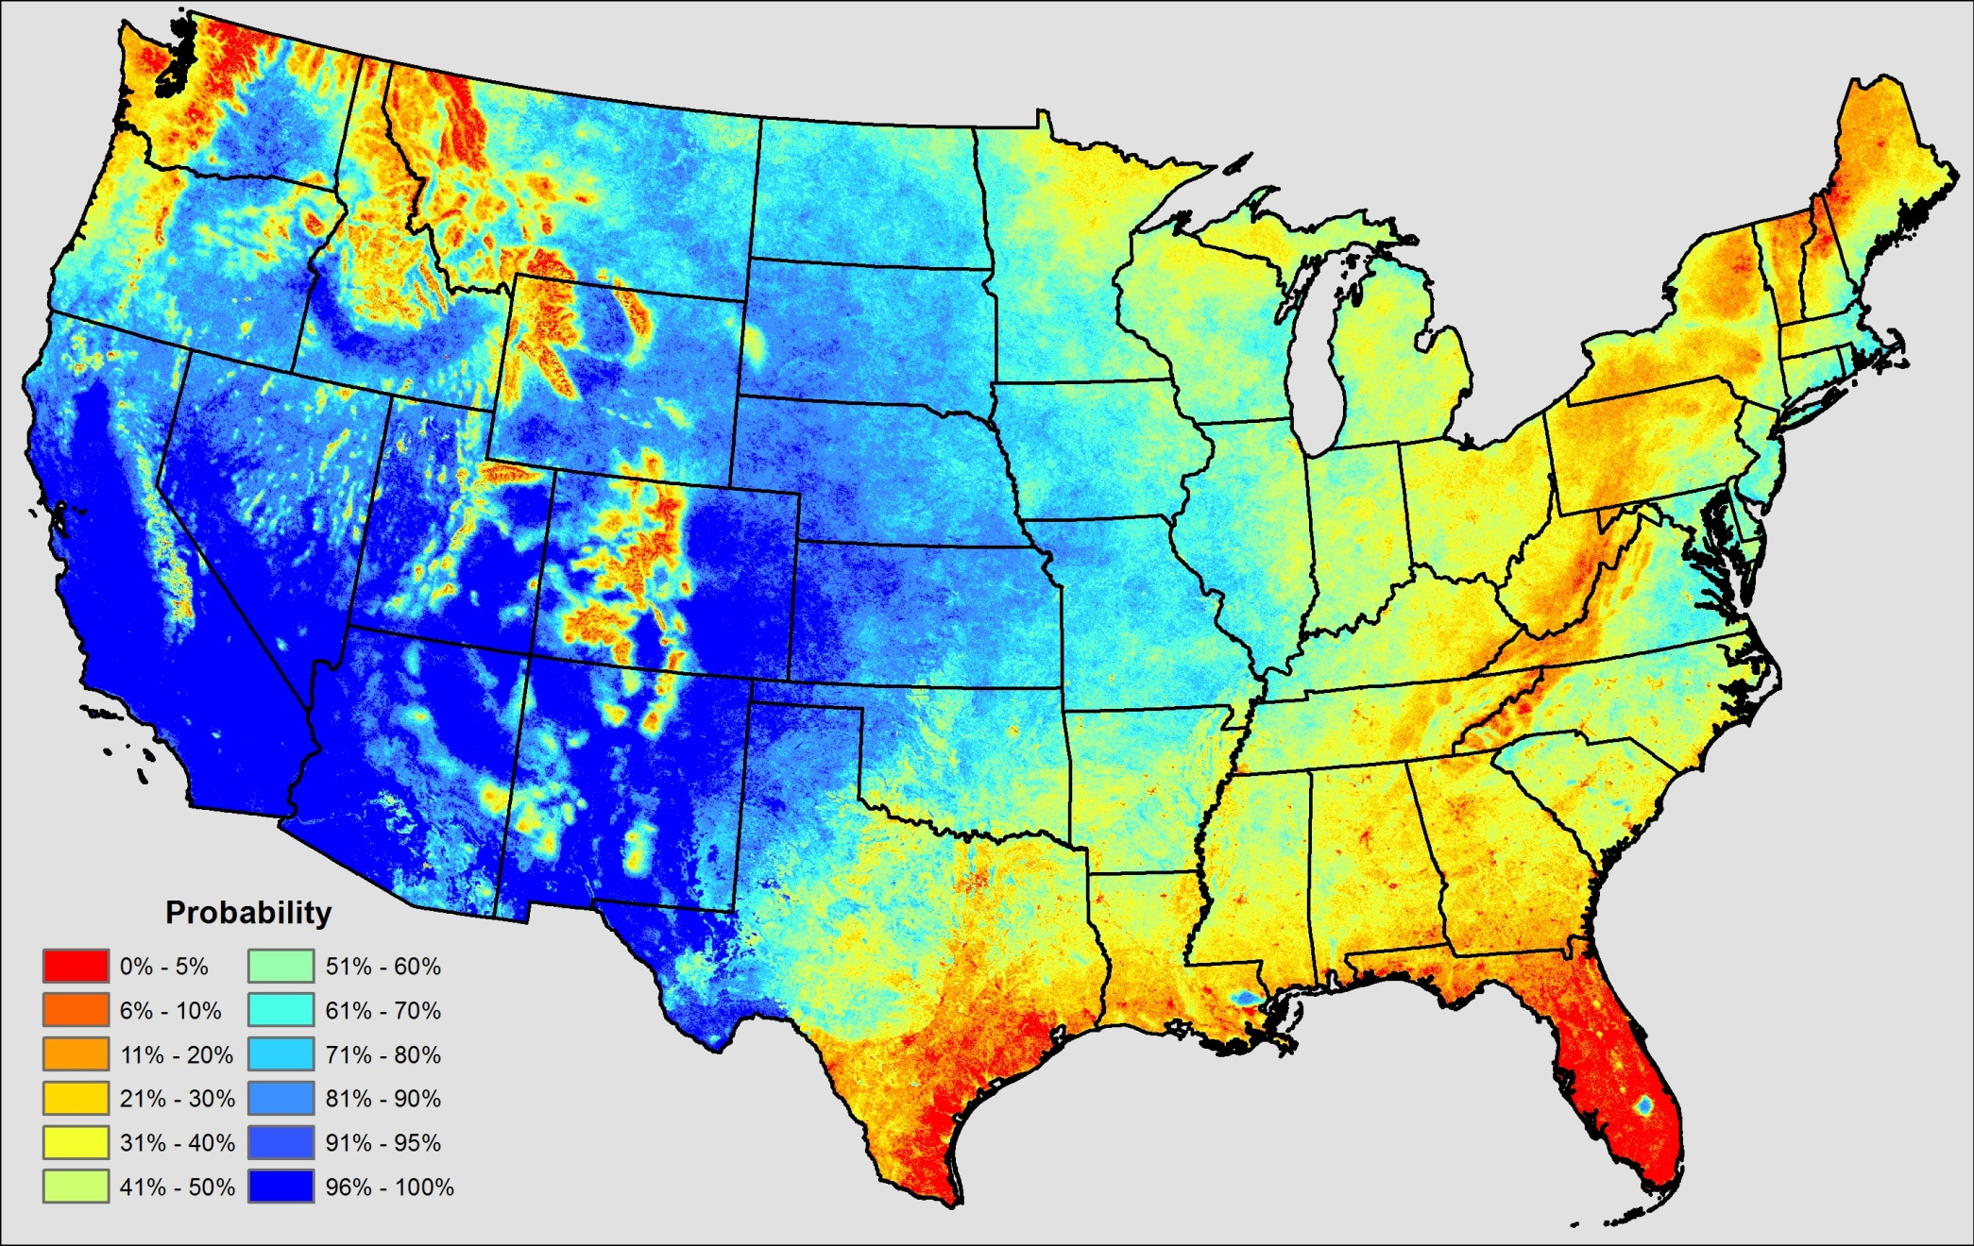
4 Satellites
Cloud free at least every 32 days

Slide 14
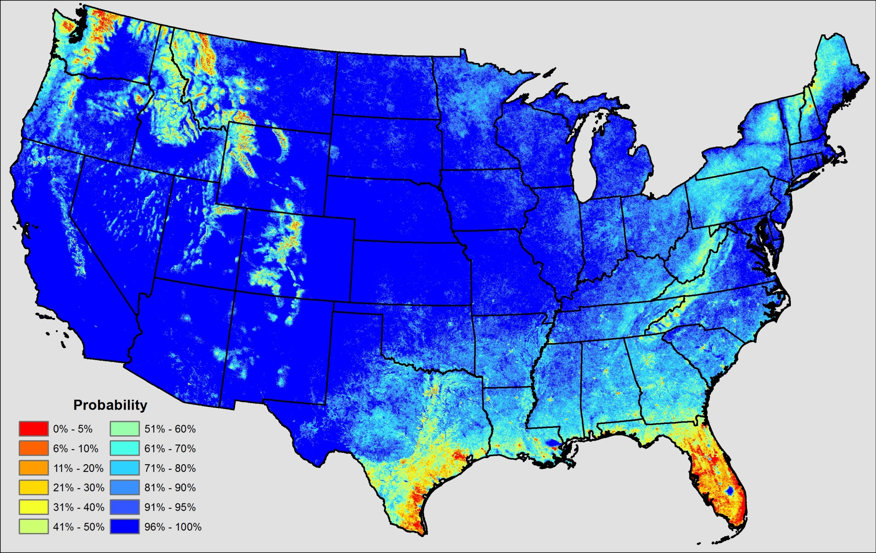
8 Satellites
Cloud free at least every 32 days

Slide 15
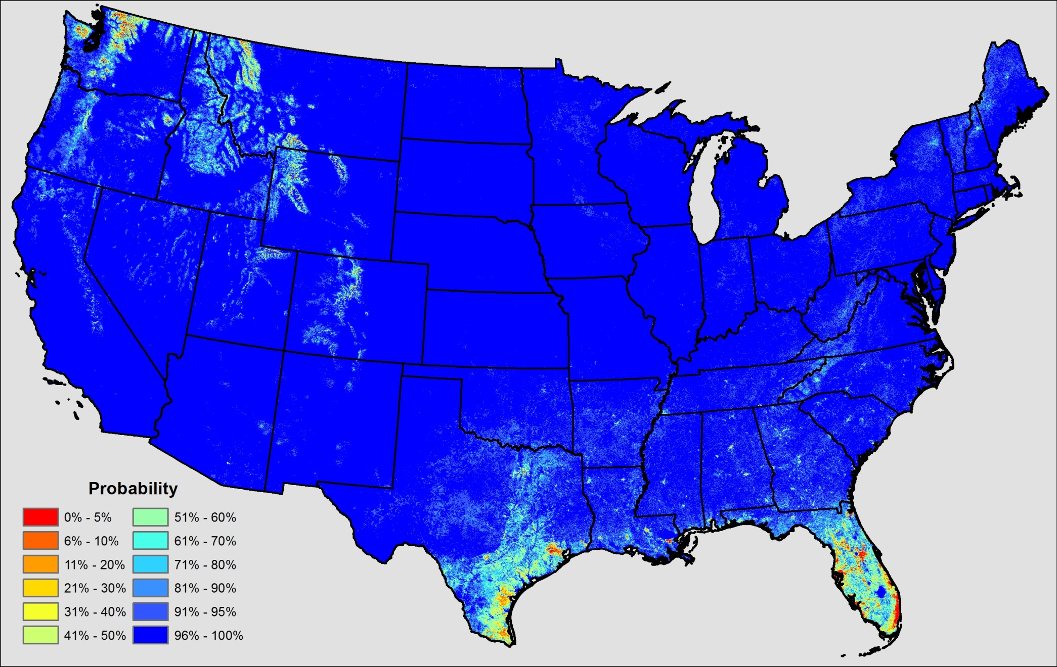
16 Satellites
Cloud free at least every 32 days

