Slide 1


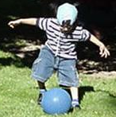

Nutrition for
Young Children
Fats and Oils Group
(Insert your name here)
Workshop Presentation
Notes:
You are viewing a presentation on the nutrition needs for young children. This presentation will provide the information you need to offer children food that will best support their growth and development.

Slide 2

Nutrition for Young Children
This presentation is intended for trainers to provide detailed information about the fats and oils group.
The project was supported by the National Research Initiative of the USDA National Research Initiative Grant # 2006-55215-16726
Notes:
This presentation is intended for trainers to provide detailed information about foods in the fats and oils group.

Slide 3
Objectives
The learner will be able to:
Describe appropriate communication with children.
Describe the key nutrients found in fats and oils.
Describe how the nutrients in fats and oils benefit the body.
Recognize the difference between saturate fats and trans fats from monounsaturated fats and polyunsaturated fats.
Identify the recommended intake of fats and oils.
Identify foods that are high in fat.

Slide 4
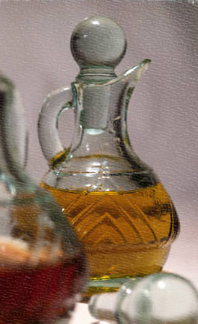
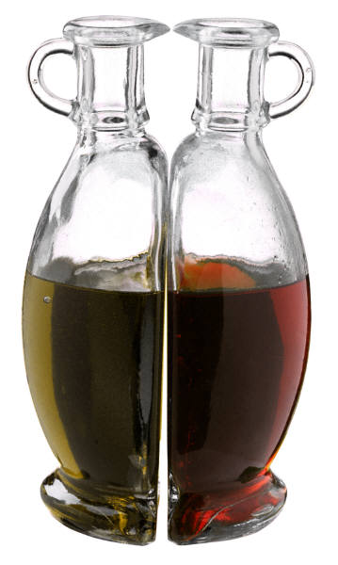
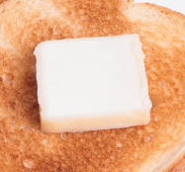
Fat/Oils
Notes:
The next group to review is the fat and oils group. Fat and oil is present in items such as butter and liquid oils, but it is also found in many other food groups too.

Slide 5
Fat/Oils
A high fat intake can be a problem!
Notes:
When fat intake is too high it can be a problem. High fat intake can lead to an intake of excess calories which may lead to weight gain. Further, depending on the type of fat consumed, the risk for developing cardiovascular disease can be increased.

Slide 6
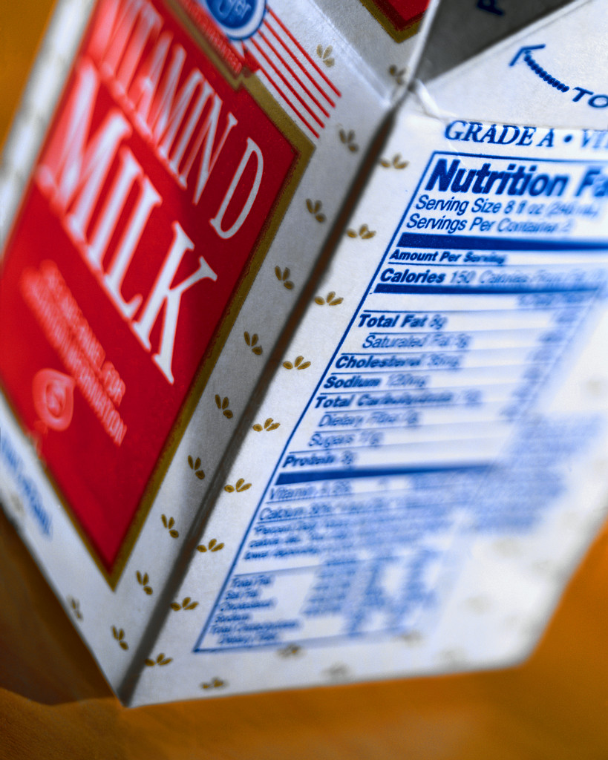
Fat/Oils
But…
Children NEED FAT in their diet!
Notes:
But before we discuss the nutrients in the fat and oils group, let us start by emphasizing that children NEED fat in their diet. Like the other five food groups, the fat and oils group provide nutrients specific to this group. With the increasing concern over childhood obesity, some adults have resorted to restricting fat intake in children’s diets. However, this is extremely harmful to their growth and development.

Slide 7

Makes children’s bodies and skin feel good!
Fat/Oils
Notes:
Makes children’s bodies and skin feel good!

Slide 8
Helps protect children’s bodies and keeps them warm!
Fat/Oils
Notes:
Helps protect children’s bodies and keeps them warm!

Slide 9
Great source of energy for children!
Fat/Oils
Notes:
Great source of energy for children!

Slide 10


Fat/Oils
Essential fatty acids
Notes:
Nutrients of particular importance in the fat and oils groups are essential fatty acids. Essential fatty acids are fats that must be consumed in the diet because the body can not make them. Essential fatty acids function to assist in the development of nerve, eye and other tissues.

Slide 11

Fat/Oils
Needed for absorption of fat soluble vitamins and calcium
FAT
FAT
Vitamin A
Vitamin D
Vitamin E
Vitamin K
Calcium
Vitamin A
Vitamin D
Vitamin E
Vitamin K
Calcium
Notes:
Fats and oils also support the body’s absorption of the fat soluble vitamins A, D, E, and K. In other words, fat has to be present in the body’s gastrointestinal tract in order to absorb these nutrients. In addition, fat has an indirect role on calcium absorption. Since vitamin D must be present to support calcium absorption, if vitamin D is not available due to a of fat intake then a deficiency of calcium will result.

Slide 12
Fat/Oils
Types:
Saturated
Polyunsaturated
Monounsaturated
Trans fatty acids
Notes:
Although it is essential for children to consume adequate amounts of fat, there are different types of fats: saturated fat, polyunsaturated fat, monounsaturated fat and Trans fatty acids.

Slide 13
Most Healthful
Polyunsaturated
Monounsaturated
Fat/Oils
Notes:
The most healthful type of fat to offer children is polyunsaturated fats and monounsaturated fats. Polyunsaturated fats are found in vegetable oils and monounsaturated fat is found predominantly in olive, canola, and safflower oils.

Slide 14
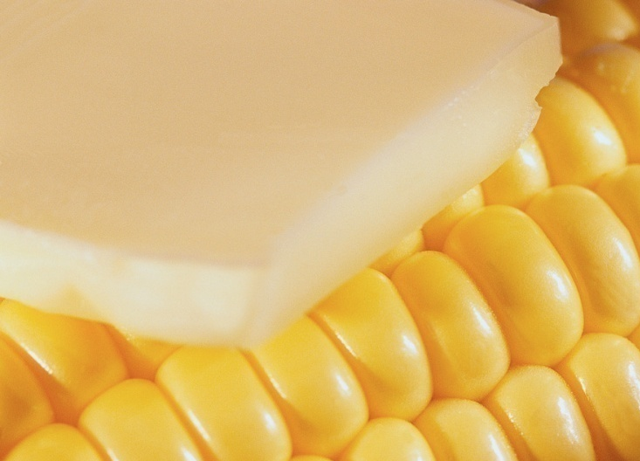
Fat/Oils
Limit
Saturated
Notes:
The other types of fats are saturated fat and Trans fatty acids. Saturated fat is found mostly in butter and meat products. Intake of saturated fat should be limited due to the impact of a high saturated fat diet and the risk of chronic disease such as cardiovascular disease.

Slide 15
Avoid
Trans fatty acids (worst)
Found in some crackers, chips, cookies, and other baked goods.
Fat/Oils
Notes:
The other types of fats are saturated fat and Trans fatty acidsTrans fatty acids are one type of fat that should be avoided because its’ intake is linked to cardiovascular disease. Trans fatty acids are found in hydrogenated fats such as margarine and shortening. Crackers, chips, cookies and other baked goods typically contain hydrogenated fats.

Slide 16
Children Need Fat!
Children 1-3 years 30-40% from fat
Children 4-18 years 25-30% from fat
Notes:
The bottle line, children need fat. In fact, children between the ages of 1 and 3 need 30 – 40% of their diet from fat compared to children 4-18 years of age who need about 25-30% of their diet from fat. Fat should never be restricted in children’s diets, the key is to focus on offering children a variety of food sources that offer foods high in monounsaturated and polyunsaturated fats.

Slide 17
Learn more:
www.choosemyplate.gov
www.cdc.gov/nutrition/everyone/basics/fat/index.html
Fat/Oils
Notes:
Visit these two websites to learn more about the fats and oils group.

