Slide 1
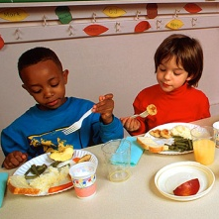

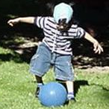
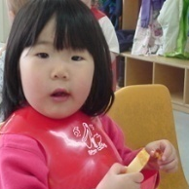
Benefits of Active Physical Play for Young Children
(Insert your name here)
Notes:
This presentation will provide the information you need to offer young children developmentally supportive and appropriate experiences and interactions, that will best support their growth and development.

Slide 2

Benefits of Active Physical Play for Young Children
This presentation is intended for trainers to provide detailed information about the benefits of active phyiscal play for young children.
The project was supported by the National Research Initiative of
the USDA National Research Initiative Grant # 2006-55215-16726
Notes:
This presentation is intended for trainers to provide detailed information about communicating active physical play for young children.

Slide 3
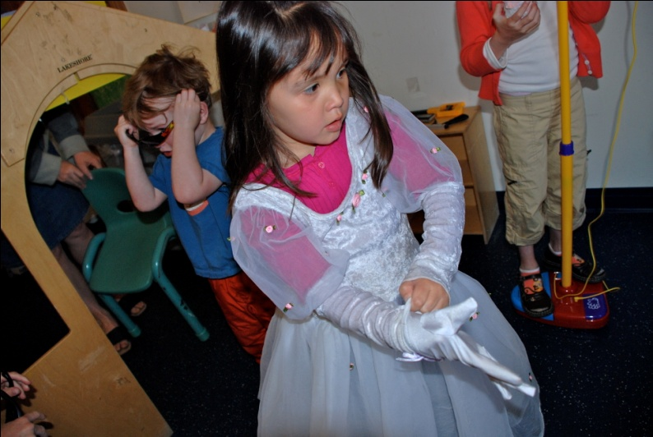
Objectives
The learner will be able to:
Describe the physical, intellectual, emotional and
social benefits of active physical play for young
children.
Notes:
By providing education, caregivers will have a better understanding on how children learn, think and how to best support them developmentally in various areas of play – physically, intellectually, emotionally and socially.

Slide 4
Why is Active Physical Play so Important?
Active physical play benefits the whole child – body, mind and soul.
Active physical play provides a variety of learning experiences for young children.
Early lifestyle choices impact children’s health and well-being, both now and in their future.
Notes:
When children are playing and moving they are doing so much more then just participating in activities. They are learning. The following slides will provide you with information about active physical play and its importance in young children’s lives.
McCall, R.M., Craft D.H. (2000) Moving with a Purpose: Developing Programs for Preschoolers of all Abilities. Printed in the United States of America Pg. 10.

Slide 5
What is Active Physical Play?
Active physical play includes anything that encourages and provides children with opportunities for development through movement.
Active physical play can occur indoors or out, it can be structured or unstructured, it can be with friends, family, child care providers, or even alone.
Notes:
Play is important, complex and difficult to define due to the many different types and the different benefits play provides for young children.

Slide 6
Physical Benefits of Active Physical Play
Active play helps children…
  Develop muscle strength.
  Build strong bones.
  Learn to control and coordinate movement.
  Improve balance and agility.
  Keep their heart and lungs healthy.
  Maintain fitness and reduce excess body fat.
Notes:
McCall, R.M., Craft D.H. (2000) Moving with a Purpose: Developing Programs for Preschoolers of all Abilities. Printed in the United States of America Pg. 11.

Slide 7
What Happens When Children Play
When children actively participate in catching,
throwing and kicking they:
  Develop the parts of the brain that coordinate movement.
  Decrease their body’s reaction time.
Notes:
7

Slide 8
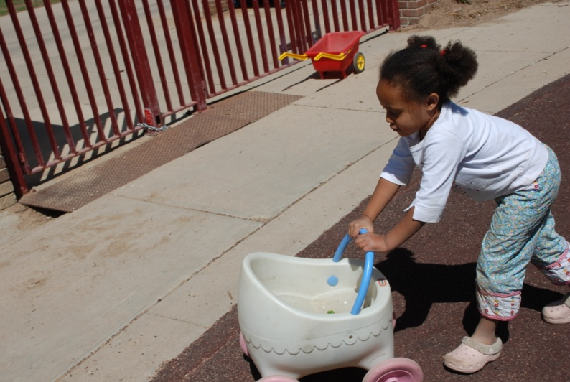
What Happens When Children Play
When children actively participate in
running they:
              Use large muscle groups in their legs, which helps them grow stronger.
              Increase lung and heart function.
Notes:
8

Slide 9
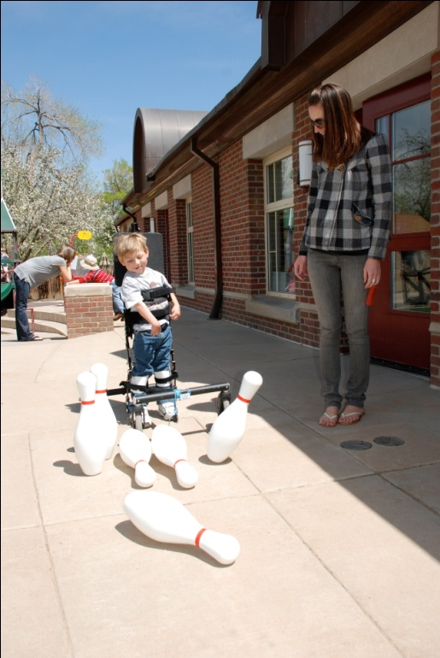
What Happens When Children Play
When children actively participate in
jumping they:
            Strengthen their bones.
            Strengthen their leg muscles.
            Increase their balance and agility.
Notes:
McCall, R.M., Craft D.H. (2000) Moving with a Purpose: Developing Programs for Preschoolers of all Abilities. Printed in the United States of America Pg. 11.

Slide 10
Intellectual Benefits of
Active Physical Play
Active physical play promotes brain development by creating and maintaining important neural pathways.
Active physical play helps the mind process and improve language skills.
Active play supports creativity, logical
reasoning, and problem-solving skills.

Slide 11
Intellectual Benefits of
Active Physical Play
  Active physical play helps children to express creative and abstract ideas.
  Through active physical play, children learn to estimate space and distance.
  Active physical play helps children learn to recognize colors and textures.
Notes:
McCall, R.M., Craft D.H. (2000) Moving with a Purpose: Developing Programs for Preschoolers of all Abilities. Printed in the United States of America Pg. 11.

Slide 12
Emotional and Social Benefits of Active Physical Play
Through active physical play children gain confidence and self-esteem.
Active physical play decreases children’s anxiety, stress, and depression.
Active physical play teaches children how to build beneficial relationships with peers.
Active physical play helps children learn to communicate with others
Notes:
McCall, R.M., Craft D.H. (2000) Moving with a Purpose: Developing Programs for Preschoolers of all Abilities. Printed in the United States of America Pg. 11.

Slide 13
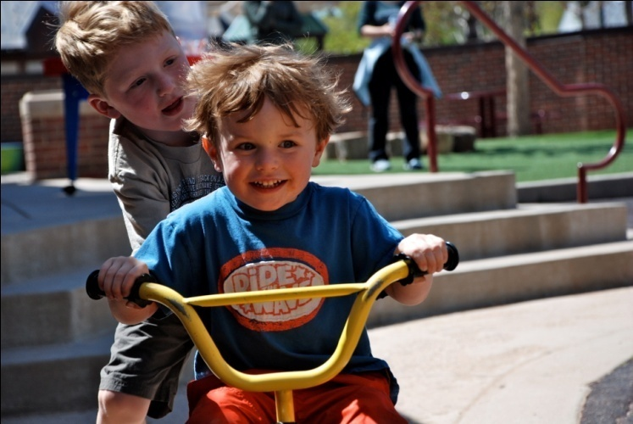
Communicating with Children about Active Physical Play
Share important messages about active play with young children.
Active play:
                Helps you grow taller!
                Makes you stronger!
                Is good for your heart!
Notes:
13

Slide 14
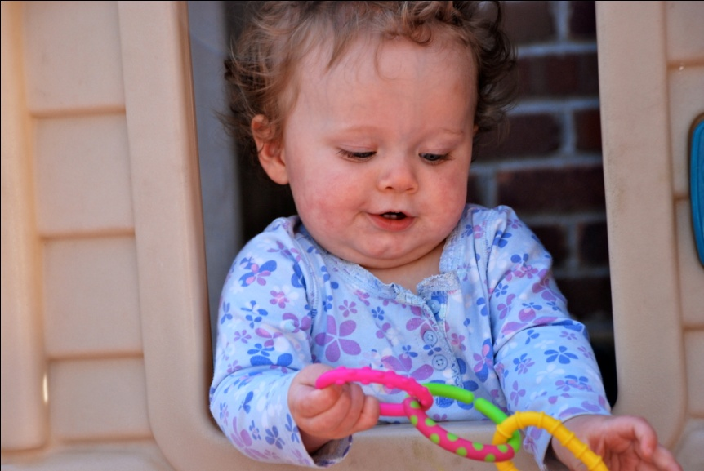
Be consistent, truthful and repetitive in your messages to young children!
Active play:
                Helps you learn!
                Is good for your brain!
                Uses your imagination!
                Makes you happy and healthy!

Slide 15
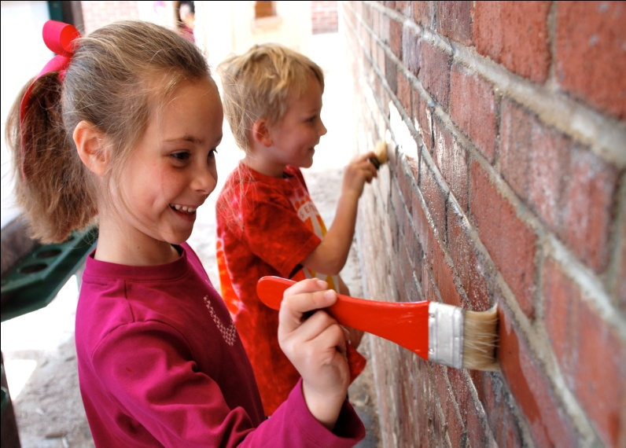
What to Say
Playing actively helps you:
Feel happy!
Make new friends!
Feel good on the inside
and the outside!

Slide 16
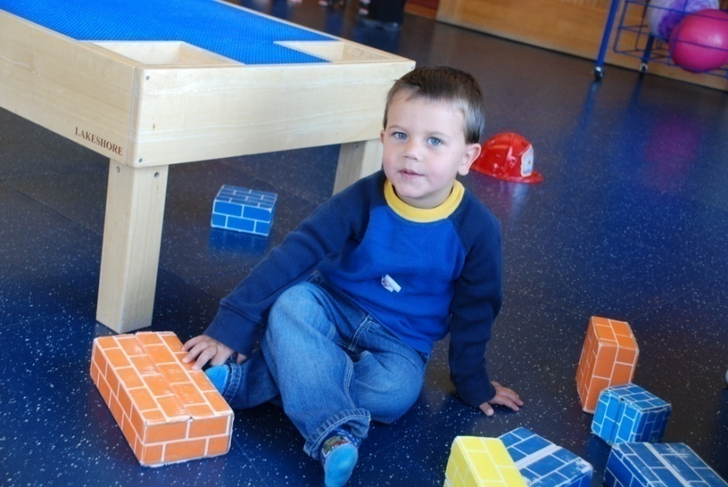
My Pyramid Recommendations for Active Physical Play
Children between 2-5 years of age should be encouraged and given the opportunity for active play every day of the week for at least 30-60 minutes a day.
Notes:
Continuous, ongoing play for 30 – 60 minutes straight is not necessary or realistic for young children. Young children play actively in spurts and should be given multiple opportunities throughout the day to engage in both structured and unstructured activities, rather than focusing on one long duration of activity.

Slide 17
My Pyramid Recommendations for Active Physical Play
To learn more about the great benefits of active play and physical activity visit the My Pyramid website at:
http://www.mypyramid.gov/preschoolers/PhysicalActivity/index.html
Notes:
To learn more about the great benefits of active play and physical activity visit the My Pyramid website at http://www.mypyramid.gov/preschoolers/PhysicalActivity/index.html

Slide 18
My Pyramid Recommendations for Active Physical Play
Young children play actively in spurts.
They need multiple opportunities through the day to engage in active play.
Notes:
Again – continuous (or ongoing) play for 30 – 60 minutes is not necessary. Young children play actively in spurts and should be given multiple opportunities throughout the day to engage in both structured and unstructured activities, rather than focusing on one long duration of activity.

Slide 19
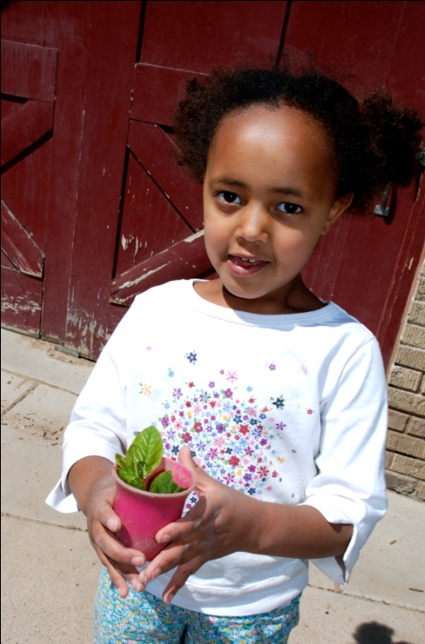
Supporting Active Physical Play
Take a little time everyday to help children…
        Grow their bodies physically.
        Develop their minds.
        Glow…because they are healthy and
        happy inside and out.
Notes:
Fortunately, many children find playing actively comes naturally, and they readily participate. However, caregivers can broaden children’s experiences of playing actively by incorporating a variety of different developmentally and age appropriate, structured and unstructured, as well as indoor and outdoor opportunities to play, learn, and grow. This variety of experiences will also help the child who finds it harder to participate in active physical play.
19

