Slide 1


4th Edition  ECS 013
INTRODUCTION
© University of Idaho Extension—Ready, Set, Food Safe – 4th Edition

Slide 2
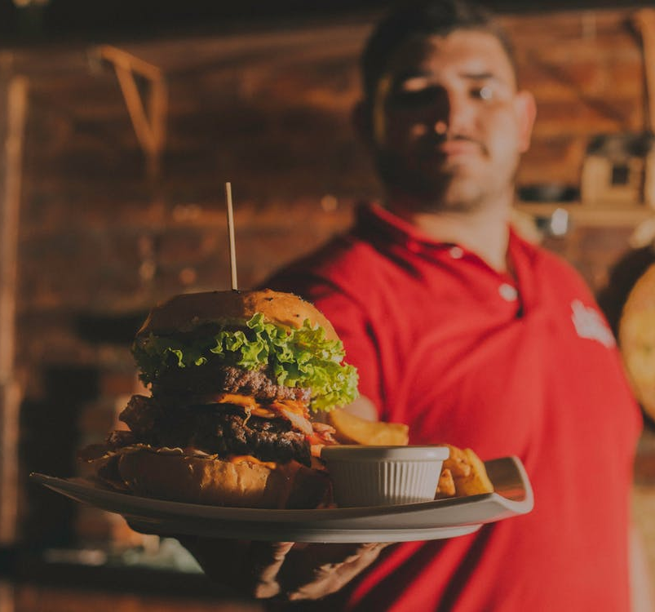
welcome
Ready, Set, Food Safe is a program:
Developed at the
University of Idaho
Provides training in food safety as it applies to Idaho food service establishments
For high school students

Slide 3
preview
What to expect
9 lessons
with activities and songs
Understanding checks
at the end of each lesson
Fill-in notes
to help you study
Certification test
pass with 80% to receive Idaho food safety and sanitation certificate, good for 5 years

Slide 4

Food safety songs
Lyrics written by Dr. Carl Winter, Extension Food Toxicologist and Director of the Food Safe Program, University of California
Winter combined scientific and musical training to write parodies of popular songs to enhance food safety education

