Slide 1
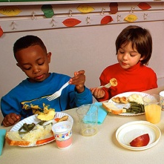

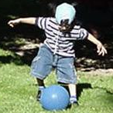
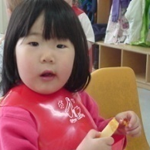
Active Play for
Young Children
An overview of play
(Insert your name here)
Notes:
You are viewing a presentation on active play for young children. This presentation will provide the information you need to offer young children developmentally supportive and appropriate experiences and interactions, that will best support their growth and development.

Slide 2

Active Play for Young Children
This presentation is intended for trainers to provide detailed information about active play for young children.
The project was supported by the National Research Initiative of
the USDA National Research Initiative Grant # 2006-55215-16726
Notes:
This presentation is intended for trainers to provide detailed information about active play for young children.

Slide 3
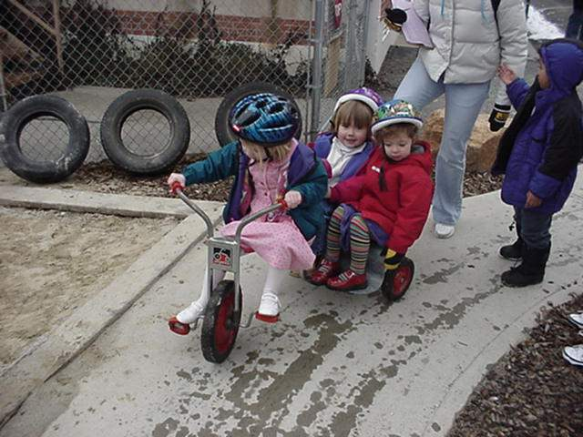
Objectives
The learner will be able to:
Explain the importance of active
play for young children.
Define different types of play.

Slide 4
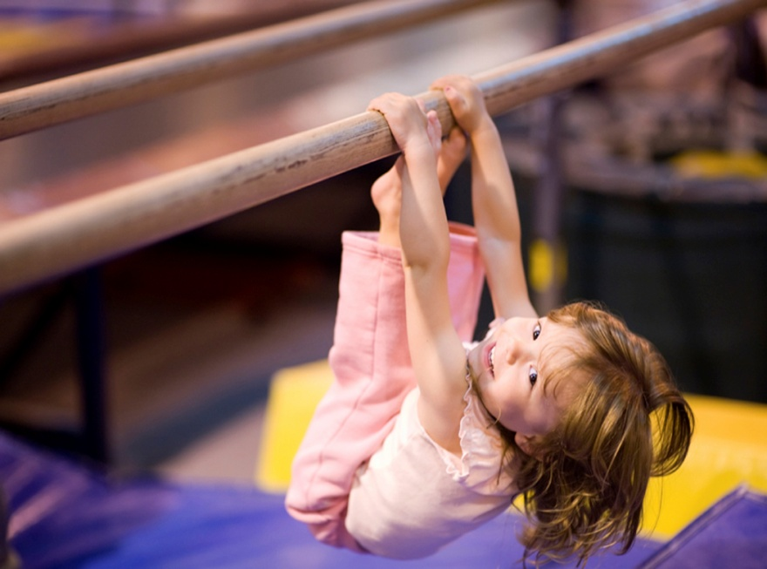
Rethinking Physical Activity:
Focusing on Fun and Play
Active physical play is how young children get their exercise.
Notes:
Play improves all aspects of children’s well-being. This includes cognitive skills, physical development, social and emotional skills, and communication skills. For children, being physically active consists of active playing.

Slide 5
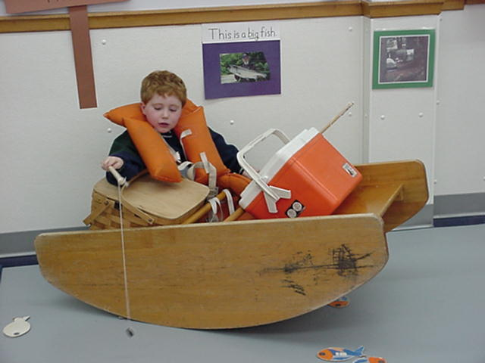
What is Play?
Play is the spontaneous activity through which children learn.
Active play is anything that encourages and provides children with opportunities for physical development. The USDA’s definition of active play is anything that gets children moving.
Notes:
For young children, active play goes hand in hand with learning, communicating, and connecting with people and the world around them. Not only is active play fun, but it also provides young children with a variety of different learning opportunities.
The United States Department of Agriculture has materials to help with active play.

Slide 6
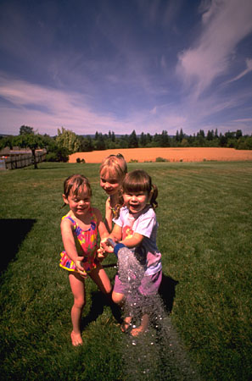
Structured vs. Unstructured Play
Structured play includes play experiences in which the adult interacts with the child by leading or initiating an activity.
Unstructured play includes child-driven activities and experiences, where children learn how to create.
Notes:
Through these experiences and interactions with the world, children learn about their environment and the people in their environment .

Slide 7
What is Appropriate Play?
Developmentally appropriate play is the concept that children learn at a pace that is appropriate for their stage of development.
Developmentally age appropriate play refers to activities and materials that are appropriate to a child’s age,
Individually appropriate play refer to activities that are appropriate and unique to the individual child’s development.
Notes:
Developmentally appropriate activities are meaningful to the children who experience them and serve as opportunities to learn and practice skills related to their current developmental stage and age. Developmentally appropriate practices meet children where they are as individuals and challenge them to work toward attainable goals.
Bredekamp, S. (2010) Effective Practices in Early Childhood Education: Building a Foundation. New Jersey. Merrill Pg. 72.

Slide 8
Children Learn through Play
They build awareness of others.
They learn to get along with others.
They create solutions to problems.
They develop and refine coordination.
They build confidence in their bodies.
They learn to use their imaginations.
They just plain have fun!
Notes:
Active play in the early years of life, is a very important part of development that helps children grow intellectually, emotionally and physically.
When choosing play activities for infants, toddlers and young children, focus on activities that are age appropriate, developmentally supportive, and fun.

Slide 9

Benefits of Active Physical Play
Active play benefits the whole child – body, mind, and soul.
Active play provides a variety of learning experiences for young children.
Early lifestyle choices impact children’s health and well-being, both in the moment and in their future.
Notes:
If that isn’t enough, active play keeps your heart healthy and strong, provides social experiences, supports good sleep, and improves academic performance.

Slide 10
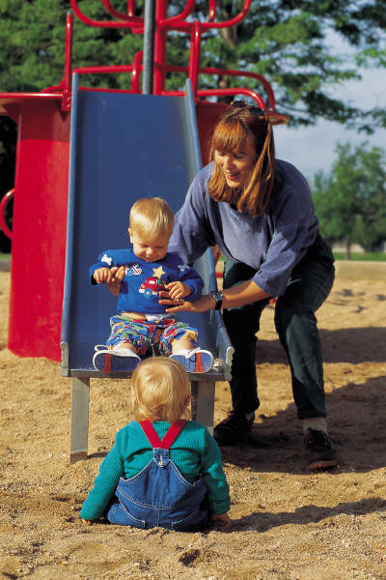
Risks of Inactivity
When children are not given the opportunity and support needed to be active, they are more at risk for health problems:
            Overweight or obesity
            Depression
            Diabetes
            Respiratory problems
Notes:
The lifestyle choices you make for yourself and those in your care affect each person’s health and well-being now, as well as in the future. Poor choices, including an unhealthy diet and sedentary behavior, are contributing factors to many health problems.

Slide 11
Active Play Recommendations
• Young children are entitled to the opportunity and should be
encouraged to participate in moderate to vigorous physical
activity every day.
Active physical play in young children may not be sustained for
60 minutes; however, they should participate in a range of
activities for at least 30-60 minutes a day, over the course of a
day.
To learn more about the benefits of active play and physical activity visit the My Pyramid website at www.mypyramid.gov/preschoolers/PhysicalActivity/index.html
Notes:
Children should to be encouraged and be given the opportunity for to be active every day of the week for at least 30-60 minutes a day.
Remember that there is a wide range in abilities of toddlers and young children, so activities should be tailored to the child—concentrating on actions rather than outcomes.

Slide 12
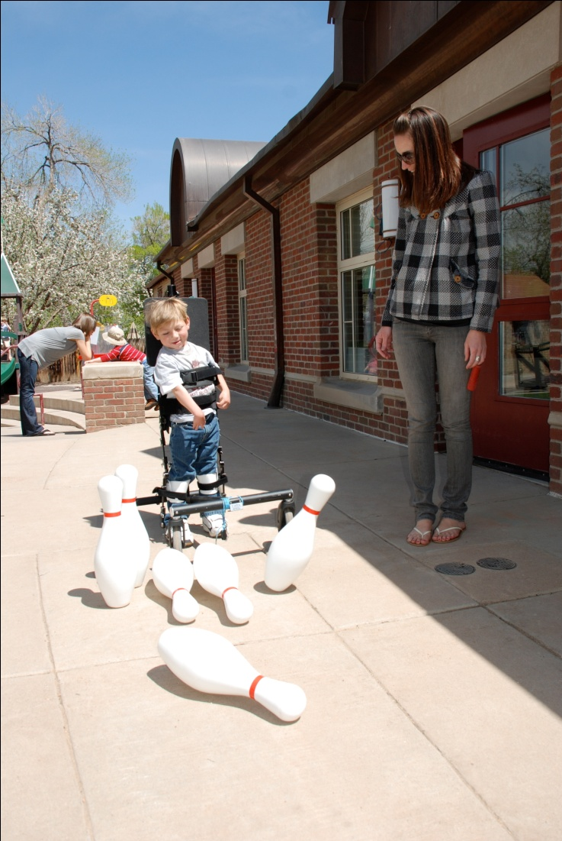
Working Together as Partners
A partnership between a parent and teacher occurs when both parties are working together, and each is focused on the best interests of the child.
Notes:
With the high prevalence of childhood obesity, it is unlikely that healthcare professionals alone can solve this serious health problem. Teachers and parents are the most influential and important resource young children have.
By getting parents, teachers, and healthcare providers to work together as partners, children have the opportunity to adopt a balanced, active, healthy lifestyle now, which will affect and enhance their future.

Slide 13

Finding a Balance
Striving for a balance between a busy adult lifestyle and active physical play with children is in the best interests of children and families.
Notes:
Young children are physically active in different ways and for different reasons than adolescents and adults. It is essential for active play to be promoted and encouraged both at home and at in the early childhood program setting.
Physical fitness, health and wellness habits are formed early on in life. Children and their families benefit from caregivers that ensure and promote an active lifestyle, physical development and health by prompting children to participate in active physical play daily.
13

Slide 14
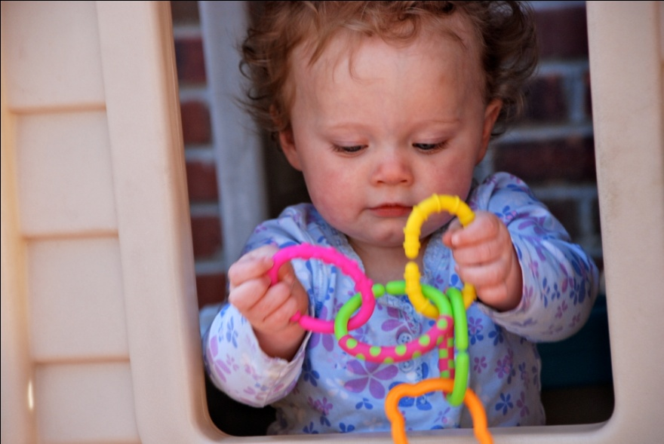
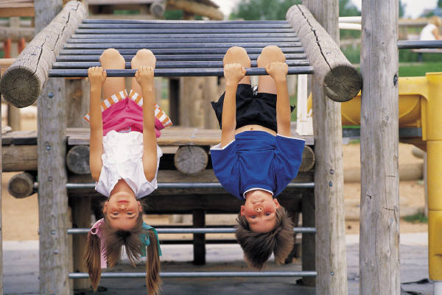
Reflect and Remember
Time is precious;
so is childhood.
Notes:
Many times we take for granted the opportunity we have been given to make a lasting, positive contribution in the lives of young children in our care and to make a significant difference in the world. It is important to remember that time is precious but so is a healthy childhood.
Bredekamp, S. (2010) Effective Practices in Early Childhood Education: Building a Foundation. New Jersey. Merrill Pg. 498.

