Slide 1

Presented by (insert instructor’s name)
(insert organization)
Developed by Grace Wittman, Steve Hines, Sarah Schumaker, and Susan Traver
Notes:
﻿Slide 1 The Gold Standard of Customer Relations
Introduction: Presenters make introductions; take care of housekeeping items (sign-ins, registrations, location of restrooms, refreshments, etc.).

Slide 2
What kind of jobs?
What are some of the jobs that you will hold either right now, during the summer, or shortly after you leave high school?
Probably not Bank President
or CEO of Micron!
Notes:
﻿Slide 2: What Kind of Jobs?
What are some of the jobs that you hold right now, during the summer, or you might get shortly after you leave high school?
You are probably not going to be a bank president or CEO of a major company.
We all have to work our way up to these positions and most of the jobs we have will require good customer relations skills.

Slide 3
The Fundamentals
Delivering service that makes a positive, lasting impression takes more than simple courtesy.
It starts with understanding what good service is, from your customers’ point of view.
Notes:
﻿Slide 3: The Fundamentals
Delivering service that makes a positive, lasting impression takes more than simple courtesy. It starts with understanding what good service is, from the customer’s point of view.
Customer relations go beyond just being courteous. Service providers begin to provide good customer service when they think of customer relations from their customer’s point of view.
We have all been customers. Through the course of this presentation, think of one excellent experience you have had as a customer and one negative experience you have had. How can you provide your customers with the excellent experience every time? What can you do to prevent the negative experience from happening to your customers?

Slide 4
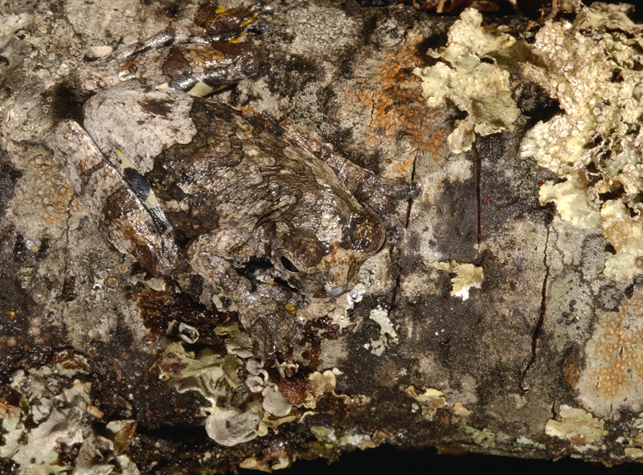
What do you see?
Notes:
﻿Slide 4: What Do You See?
What do you see in this picture?
Instructor Note: Allow a few minutes for the participants to
examine the picture.
You should see a frog.
Point out the frog.
The point of looking at this picture is that when working in customer relations, it is important to look for ways to provide unexpected service for your customers. Look for the hidden opportunities to provide your customers a positive experience.
Your customer service can often directly affect your paycheck, such as when working in a position that is paid on commission or receives income through tips. By looking for ways to provide unexpected service, you are setting yourself apart from other employees and the customer is more likely to be a loyal customer of yours.

Slide 5
How can you provide
UNEXPECTED
UNEXPECTED
experiences?
Notes:
﻿Slide 5: How Can You Provide Unexpected Experiences?
What opportunities are there in your work where you can provide something extra or special for your customers? Research shows that people are willing to pay a little more for something if they get great customer service. Also, keep in mind that your first jobs will be references for when you finish school and start applying for your career choices. You want excellent recommendations from former employers.

Slide 6
Customer relations is about:
attitude
Notes:
﻿Slide 6: Customer Relations Is About: ATTITUDE
We all have a choice when it comes to our jobs. We can choose to be in a bad mood and therefore have a bad day and maybe treat our customers poorly, or we can choose to put a smile on our face and have a good day. Choosing to be in a good mood can have a direct effect on how you treat your customers.
Customers do not care what is going on in your life—whether or not you had a fight with your significant other, or you stayed out too late. These things are unimportant to them. However, they will remember if they received poor service from someone with a poor attitude. Sometimes we just have to play the part of someone who loves their job and loves to be there.
Make your customers your number one priority and remember to provide exceptional service to them. This will ensure that they are repeat customers. Repeat customers are what keep businesses going and give you job security. You may not have a job that deals directly with the customer, but your job does have an effect on that customer. If you are a cook at a restaurant you may never actually speak with the customers, but how you do your job determines whether or not they will enjoy their meal and return again.

Slide 7
Make a Good First Impression
What does the customer experience in the
first six seconds?
Start with the right attitude.
Greet customers promptly within one minute.
Smile sincerely and maintain eye contact.
Be courteous.
Put customers at ease, build rapport.
Always look your best.
Hospitality Habits
Notes:
﻿Slide 7: Hospitality Habits—Make a Good First Impression
What does the customer experience in the first six seconds upon entering the business? Is it clean, neat, warm, and inviting? Is the outside neat and inviting? Is it somewhere that people will want to come back to?
Start each interaction with the right attitude; whether it is 8 a.m. or
5 p.m., attitude makes all the difference.
Greet your customers within one minute. People like to be noticed, but it isn’t necessary to immediately hover over them unless they have questions or problems that they need help with. Also, in a retail situation, acknowledging customers can reduce shoplifting because they will know you know they are there, and they have been noticed.
Be courteous, smile sincerely, and maintain eye contact. Show a genuine interest in your customers. They chose your place of business to spend their money. It costs you nothing to show appreciation.
Build rapport with your customers. Get to know their names, especially if you have repeat customers (and that is the goal). People are habitual and will frequent places where they feel comfortable.
Always look your very best. Dress for what is appropriate for your clientele. This is where it is imperative that you know your customers. It is always best to lean toward the conservative. Self-expression is a great thing, on your own time. Many companies will have a policy on this.
Optional Activity: Determine what kind of first impression you make on customers, using the First Impressions activity included in the Supplemental Materials section.

Slide 8
Know Your Job
Know the full name and spelling of your place of business.
Know the complete address, phone number, and directions.
Know the products and services you provide.
Know all the systems, procedures and policies.
Be able to use all equipment properly.
Hospitality Habits
Notes:
﻿Slide 8: Hospitality Habits—Know Your Job
It is important to know the full name and spelling of your place of business. Customers will ask you from time to time where you’re located and how to spell the name. If you can’t answer them, it doesn’t look very good for the business.
Also, knowing the address, phone number, and directions for how to get to your business will come in handy. If you can’t give directions to your business or the telephone number to a customer, you can’t expect them to become customers, can you?
The best thing you can do for the customer is to learn about the products and services that your business offers, as well as how to run equipment. For instance, if you work in a salon and you have no idea what services the salon offers, you won’t be of much help to a customer calling to inquire about them.
It is also important to learn policies and procedures for a business. This particularly comes in handy when dealing with a problem customer. You need to be able to answer questions effectively or at least be able to point the customer in the direction of someone who can help them. Giving customers the run around or just saying “Gee, I don’t know what to do” doesn’t cut it. The customer wants action and wants it quickly.
Optional Activity: A variety of activities could be used here. We recommend the Human Web activity, included in the Supplemental Materials section.

Slide 9
Know Your Community
Know how to get around and how to give correct and easy directions.
Be able to describe main attractions.
Keep informed of events.
Be able to use visitor resources.
Know about other businesses, what they offer and their location.
Hospitality Habits
Notes:
﻿Slide 9: Hospitality Habits—Know Your Community
It is important that businesses help each other in small communities. Know how to give easy-to-follow directions to other businesses and attractions within the community. If you aren’t familiar with the community, educate yourself. Visitor bureaus will have maps. If you are working in a portal business (hotels, restaurants, c-stores, or gas stations), you will be asked for directions daily.
The longer travelers can be kept in town, the more money they will circulate. Be able to describe main attractions and major events taking place. Give visitors interest in the community, or give them a reason to come back. Research has shown that travelers spend most of their money in communities two ways: meals and hotel rooms.
Optional Activity: Understand the importance of learning about your community with the Where Can I Get It activity, included in the Supplemental Materials section.

Slide 10
Communicate Clearly
Listen carefully for clues (80% is nonverbal).
Recognize feelings and concerns.
Ask questions to be sure of what the customer wants.
Answer questions clearly. Avoid using local slang or technical terms that may not make sense.
Be reliable. Do what you say by when you say it will be done. Get it right the first time.
Hospitality Habits
Notes:
﻿Slide 10: Hospitality Habits—Communicate Clearly
Two essential things you can do in your job are to be observant and listen to your customers. Much of what we say as human beings is nonverbal, so paying attention to your customers’ verbal and nonverbal cues can help you better assist them.
You need to recognize the feelings of your customers, especially if your customer is upset. Many times, you can put your customers at ease when they see that someone understands what they are going through. By recognizing these feelings, you will have a better chance of understanding the problem and how to help the customer.
Asking questions can make your job a whole lot easier. You need to be willing to ask the customer questions. Think about being a customer yourself; sometimes we’re not clear with the employee about what we are looking for. So as the employee, ask questions until you understand what the customer wants.
Being a reliable employee is very important to your employer. You always want to do what you say you’re going to do and do it right the first time.
Optional Activity: Emphasize the importance of listening skills and verbal communication by using the Partner Drawing activity, included in the Supplemental Materials section.

Slide 11
Handle Problems Effectively
Listen carefully to identify problems correctly.
Use common sense to identify solutions.
If you can’t solve the problems, connect the customer with someone who can.
Be responsive, act quickly.
Work cooperatively with others.
Hospitality Habits
Notes:
﻿Slide 11: Hospitality Habits—Handle Problems Effectively
Listen carefully to the customer’s explanation of the problem. Often, people just want someone to listen. After they have been given a chance to vent, then practical solutions can be determined. Do not get into an argument with a customer.
Use common sense to identify solutions when possible. Make solutions quick and effective, but be sure you don’t break company policy in doing so. For example, if the policy states no item of clothing may be returned after wearing, then that policy must be followed. It is very important the customer is aware of such policies BEFORE they complete the purchase.
If you can’t solve the problem, connect the customer with someone who can, such as a manager. They may have the ability to offer solutions other employees don’t. It is important to be responsive to customer concerns. Research shows that 68% of customers quit a business because of an attitude of indifference.
Optional Activity: Emphasize the importance of listening skills and verbal communication by using the Problem Customer activity (included in the Supplemental Materials section) and engage participants by sharing customer relations experiences.

Slide 12
Make a Good LAST Impression
Ask how everything was.
Ask if the customer was taken care of and if they received everything they needed.
Make them feel good about their choice to do business with you.
Thank them for coming and invite them to come back.
Hospitality Habits
Notes:
﻿Slide 12: Hospitality Habits—Make a Good Last Impression
Making a good last impression is something we need to always remember to do. It is essential to make sure customers leave happy and satisfied with the service they received. This can be as simple as asking customers if they found everything they were looking for or if all their questions had been answered.
Always thank customers for coming in and invite them back—use their name if you know it. Customers like to feel wanted and appreciated, so do your best to make them feel this way.
Instructor Note: Select a short customer relations video to view. We have found that a video adds value and energy to the presentation. See the References and Resources list for suggested videos.

Slide 13
It really comes down to…
Treating others
as you would like to
be treated!
Notes:
﻿Slide 13: It Really Comes Down To…
Treating others as you would like to be treated!

Slide 14
?
Questions?
Notes:
﻿Slide 14: Conclusion
This concludes our presentation today. do you have any questions?
We have a short survey we would like you to take. Please do not put your name on it and when you are done, leave it on the table.

